Slide 1

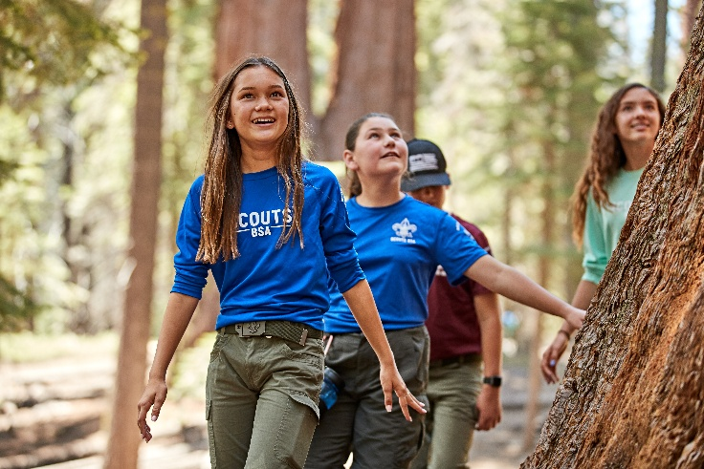

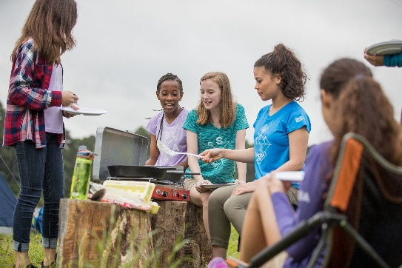
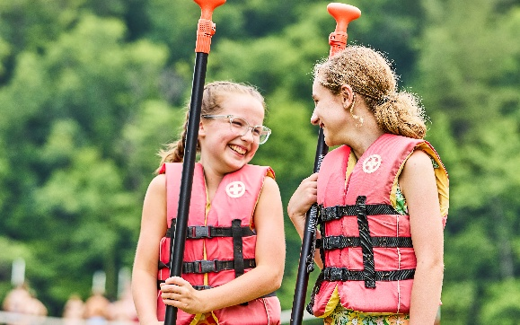
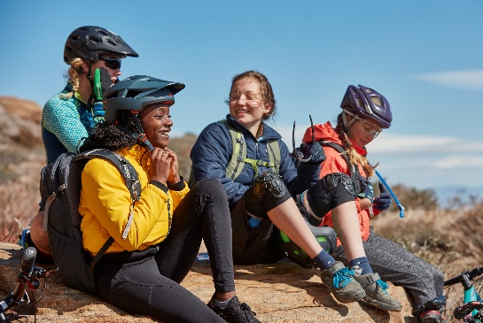

Scouts BSA
offers your daughter…:
Fun with new friends and family
Experiences that build life skills
Adventures that build confidence
Service that builds character
Grit & resilience that come
from new challenges
Scouting encourages personal growth that can help kids thrive in sports, school, and life!
Costs are very similar to other activities, and financial assistance is available.
Scouts BSA Troop ### is welcoming girls ages 11+ to join the adventure!
We regularly meet at (location,
day of week, time)
Contact us (info)
QR code to Facebook page or beascout.org pin
Compared to non-Scouts, Scouts are more likely to:
Embrace positive
social values
Develop kindness,
helpfulness, & cheerfulness
Have a greater sense of hope for their future
Learn more or join online at beascout.org

