Slide 1

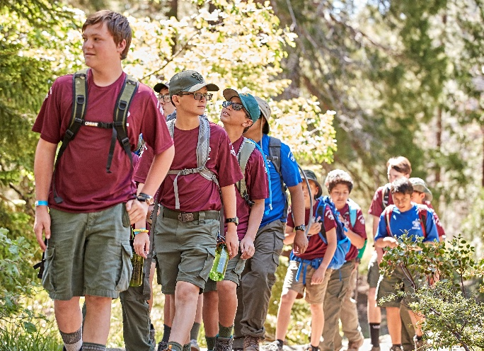

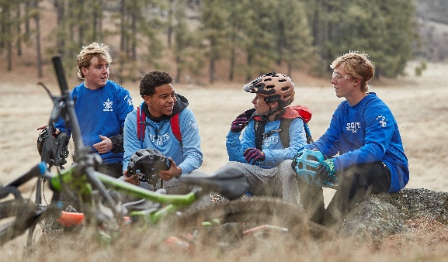
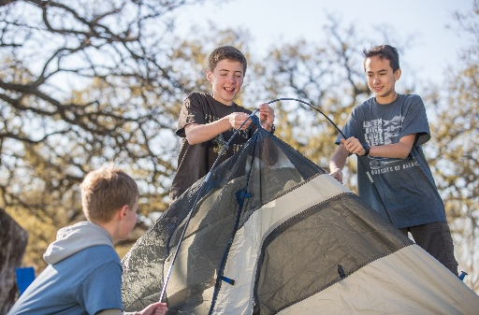
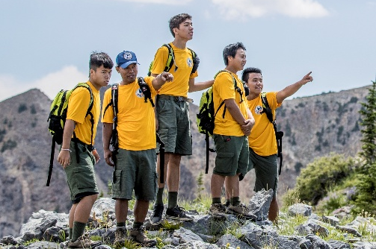

Scouts BSA
offers your son…
Fun with new friends and family
Experiences that build life skills
Adventures away from screens
Service that builds character
Grit & resilience that come
from new challenges
Scouting encourages personal growth that can help kids thrive in sports, school, and life!
Costs are very similar to other activities, and financial assistance is available.
Scouts BSA Troop ### is welcoming boys ages 11+ to join the adventure!
We regularly meet at (location,
day of week, time)
Contact us (info)
Place QR code to Facebook page or beascout.org pin
Compared to non-Scouts, Scouts are more likely to:
Embrace positive
social values
Develop kindness,
helpfulness and cheerfulness
Have a greater sense of hope for their future
Learn more or join online at beascout.org

