Slide 1
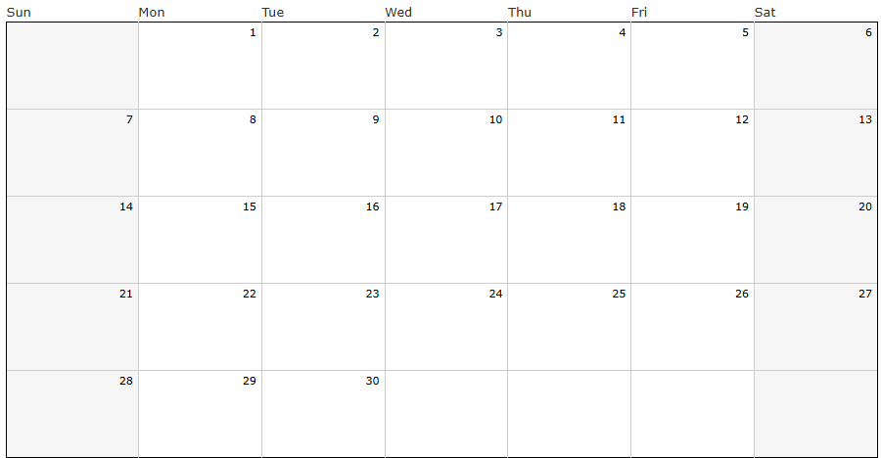
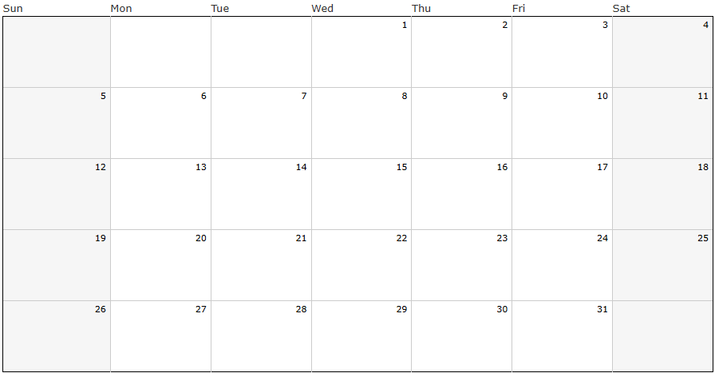
Pack/Troop ### Calendar – Fall Semester, 2025
Shift/copy/use text boxes and examples below to customize with events and reminders for your Unit – delete this text box before sharing
Day, August __ – first Pack/Den/Troop meeting, time, location
Day, August __ – event, time location
September 2025
Labor Day
text box
Cub Scout
Fall Field Day
text box
Popcorn Blitz Weekend
text box
There will popcorn storefront sales opportunities during the weeks of sales season—usually 2 hour shifts on weekends.
October 2025
Text box
********** West Side Nut Club Fall Festival – October 7-12 **********
******* EVSC Fall Break – No School **********
text box
(popcorn orders due)

Slide 2
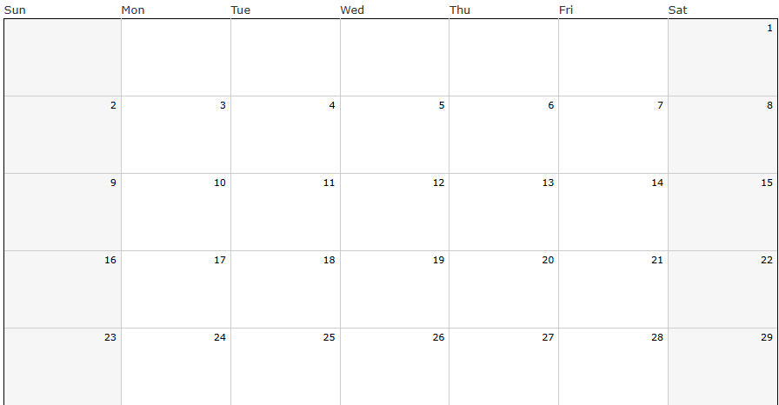
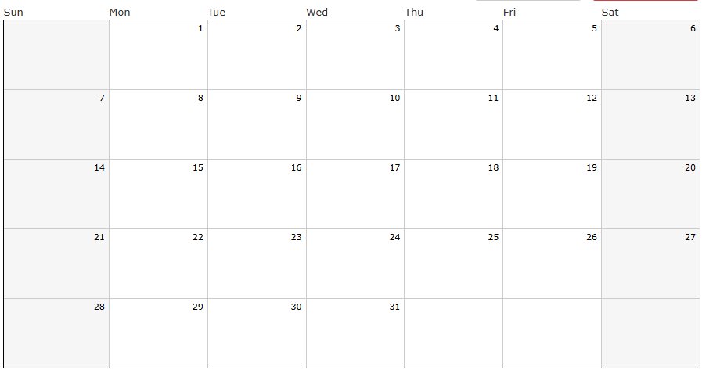
November 2025
Text box
Text box
text box
No school – Happy Thanksgiving
December 2025
Text box
Text box
text box
No school– December 22 – January 5 – Merry Christmas, Happy New Year, enjoy your break!
Jan-May 2026 calendar to come…here are first dates in January
Date/event
Date/event

