Slide 1

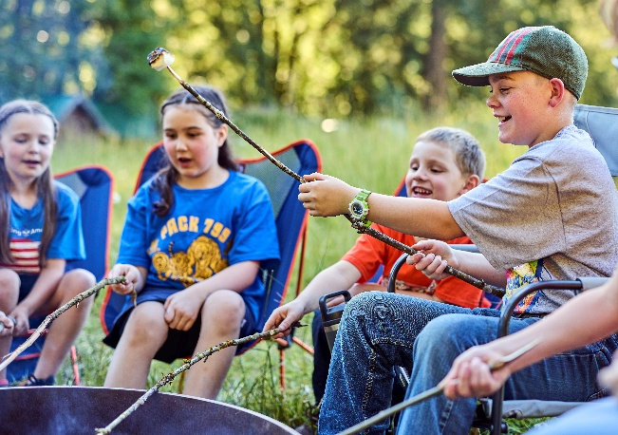

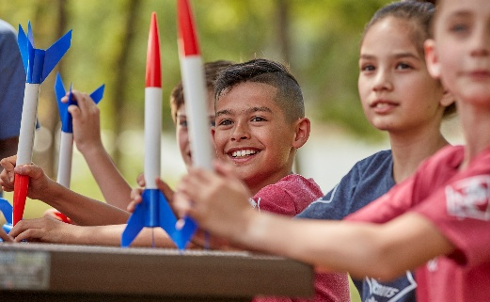
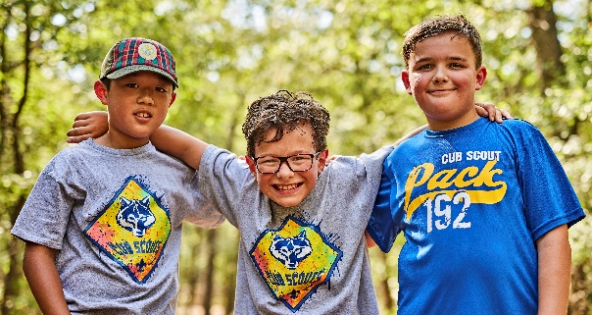
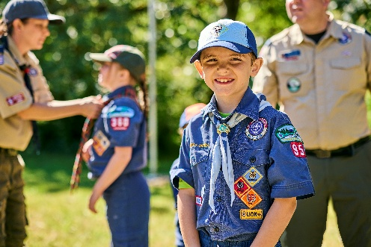

Cub Scouting
offers your son or daughter…:
Fun with family and new friends
Experiences that build life skills
Time together, away from screens
Service that builds character
Grit & resilience that come from
new challenges
Scouting encourages personal growth that can help kids thrive in sports, school, and life!
Costs are very similar to other activities, and financial assistance is available.
Cub Scout Pack ### is welcoming grades K-5 to join the adventure!
We regularly meet at (location,
day of week, time)
Contact us (info)
QR code to Facebook page or beascout.org pin
Compared to non-Scouts, Scouts are more likely to:
Embrace positive
social values
Develop kindness, helpfulness and cheerfulness
Have a greater sense of hope for their future
Learn more or join online at beascout.org

