Slide 1


Catch Them
& Keep Them
A training for
Scout Recruitment & Retention
May 2026
Developed by members of the Marketing and Membership Committee,
Buffalo Trace Council
All fishing photos in this presentation are from the Scouting America Brand Center

Slide 2
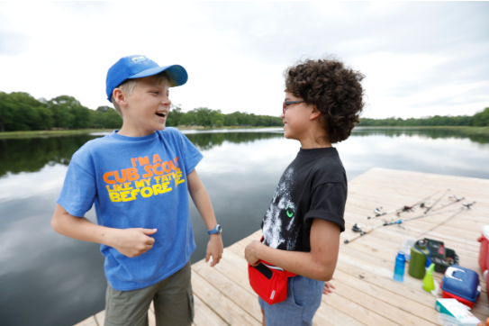
Brief Introductions

Slide 3
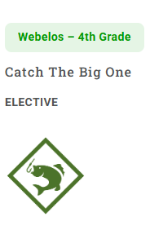
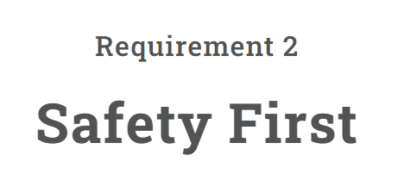
Safety Moment
Download and print a copy of Scouting America Safe Checklist for each Cub Scout. Review the example of using the SAFE Checklist for a fishing trip.
Supervision
  Adults should bait the hooks and remove fish from hooks. Watch the YouTube video Baiting A Hook With A Worm (duration 1 minute 50 seconds) and How to Remove the Hook From the Fish: Catch and Release (duration 1 minute 37 seconds.)
  When not fishing, the pole should always be held upright to prevent poking another scout or adult.
Assessment
  Inspect the site that you will fish prior to the outing. Check for any areas that could pose a danger to the Cubs such as steep banks, rocks, etc.
Equipment and Environment
  Smaller Cub Scouts should use simple gear, such as cane poles or telescoping crappie poles.
  Have a backup plan such as Backyard Bass, or another casting game ready in case the fish are not biting.
  Fish only on still waters (ponds or lakes). If fishing from a dock or wall, non-swimmers should wear a life jacket.
https://www.scouting.org/outdoor-programs/fishing/

Slide 4

Session Objectives
Provide Activities, Resources, Ideas & Best Practices for 2 Topics:
Casting Your Line: How do you attract their interest?
Catch and Keep: Registration and retention

Slide 5

Why We’re ALL Here
We know what Scouting offers our youth

Slide 6
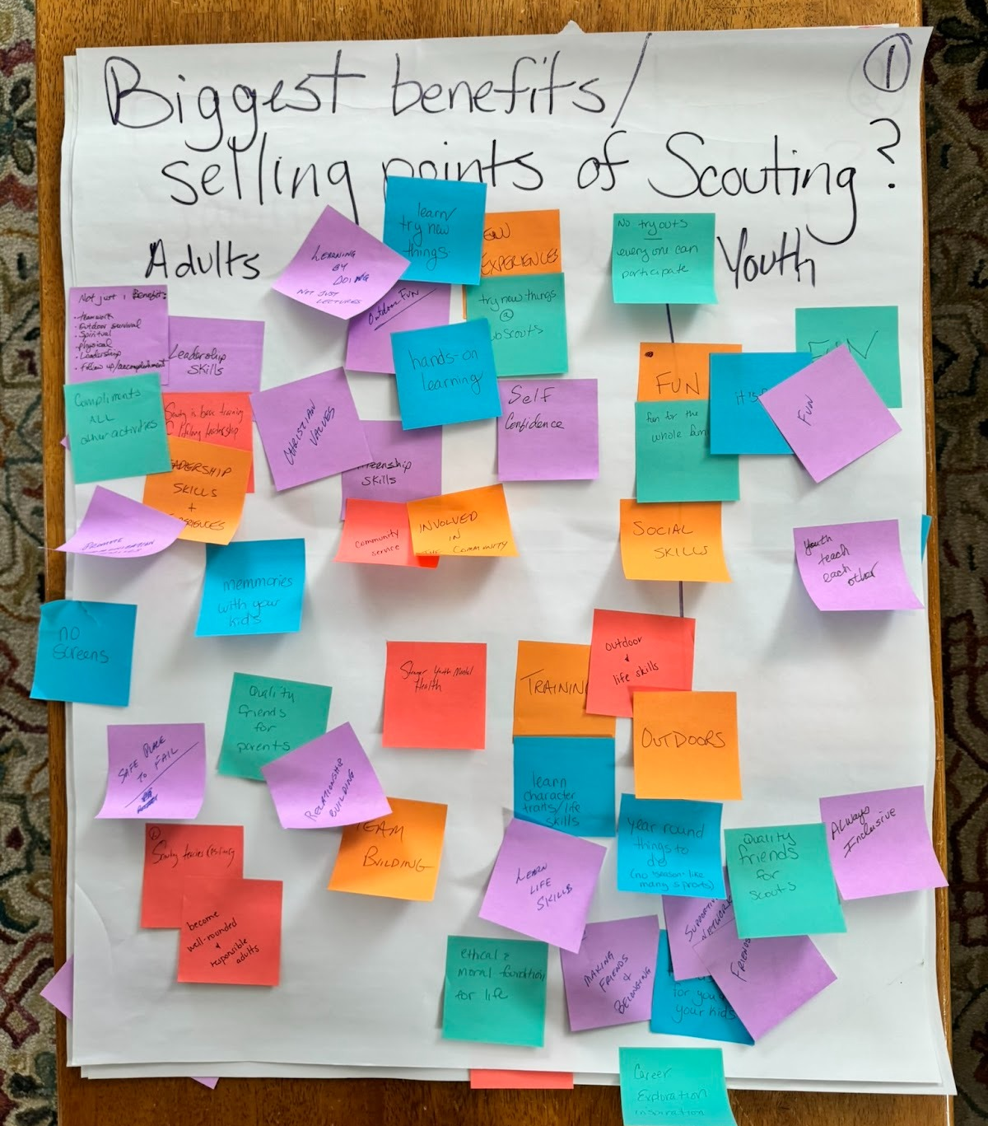
Biggest benefits / selling points of Scouting (“Why Scouting?”)
Adults (these are benefits for youth that
adults may be most aware of or prioritize):
Compliments all other activities
Memories with your kids
No screens
Safe place to fail
Quality friends for parents
Teaches resiliency
Trains for traits to be well-rounded, responsible adults
Stronger youth mental health
Physical health
Moral values

Slide 7
Biggest benefits / selling points of Scouting (“Why Scouting?”)
Both Youth and Adults:
FUN - biggest recurrent theme
Builds self confidence
(Lifelong) leadership skills
Community service
Trying new things/experiences
Outdoor adventures
Life skills
Making friends and belonging/inclusive
Quality friendships
No try-outs - everyone can participate
Career exploration
Year-round (not seasonal, like sports)
Social skills/relationships
Youth teach each other

Slide 8
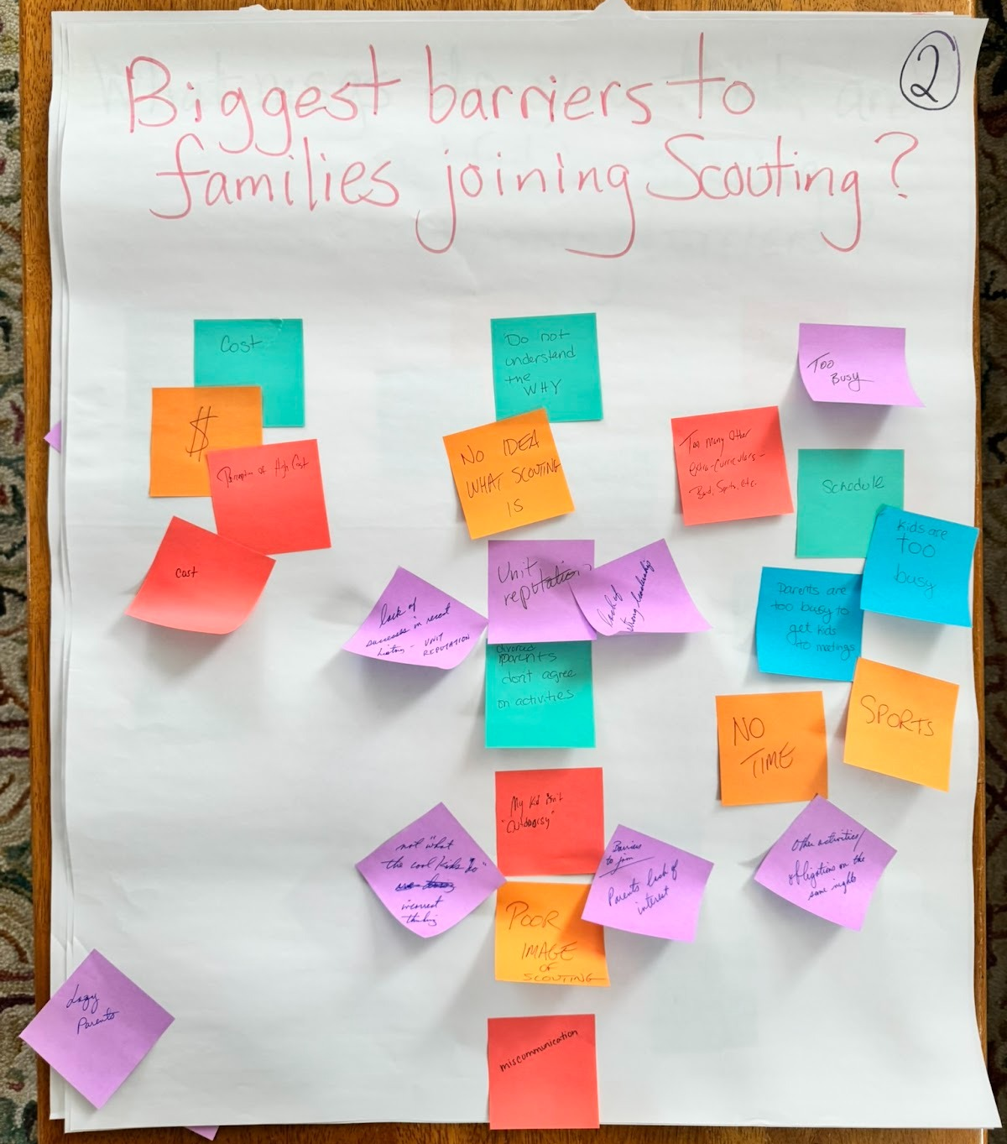
2. Biggest barriers to families joining Scouting
Three biggest, recurring themes:
  Cost / perception of cost
  Busyness/no time
  Don’t understand why/unaware of Scouting

Slide 9
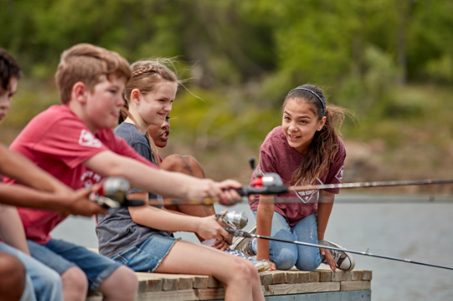
Casting
Your Line
Recruitment

Slide 10
Maximize the Good, Overcome the Challenges
Recruitment is not an event.
It is a repeatable process and system that feeds registration.
Register
Invite!
Make Access Easy
Welcome & Onboard
Create Awareness
More youth, more
families, more impact

Slide 11
National Plan:
Factors Impacting Recruiting Success
What works for recruiting Scouts, and what works against it?
AWARENESS: Do families know Scouting exists and why it matters?
ACCESS: Can families easily say “yes”?
INVITATION: Did someone personally ask them to join?
CONVERSION: Did interest turn into a registered Scout?
FRICTION: The Enemy of Recruiting
- Anything that makes Scouting harder than it needs to be
These are interdependent
Notes:
Awareness: Do families know Scouting exists and why it matters?
Visibility & Service
Schools
Community
Marketing and PR efforts
Access: Can families easily say “yes”?
Units near where families live (promoting all units, not just their own)
Schools and chartered partners
Affordability
“Emerging Markets” and multicultural pathways
Invitation: Did someone personally ask them to join?
Peer-to-peer asks
New Member Coordinators
Unit Growth Executives
Parent Champions
Bring-A-Friend moments
Conversion: Did interest turn into a registered Scout?
Joining Events
BeAScout follow-up speed
Simple registration
Clear value proposition
Friction: The Enemy of Recruit/Retain
Anything that makes Scouting harder than it needs to be
Cost confusion
Poor communication
Scheduling issues

Slide 12
Creating Awareness, Promoting Access
Being Prepared At All Times To Invite & Welcome New Scouts
Council / M&M Committee Responsibilities
  Training and support
  Overall/mass awareness and advertising
    marketing and communications
      digital targeting
    Scouting visibility
  Providing resources for units and guidance on how to use
Unit-Level Responsibilities
Recruitment and retention mindset
  Unit leaders with this as their focus
Recruitment-focused events
Relationships & visibility in schools/community
Encourage personal invitations
  Persistence matters – 7 points of contact
Deliver the program
  Unit-level activities and communication
  Using provided tools & best practices

Slide 13
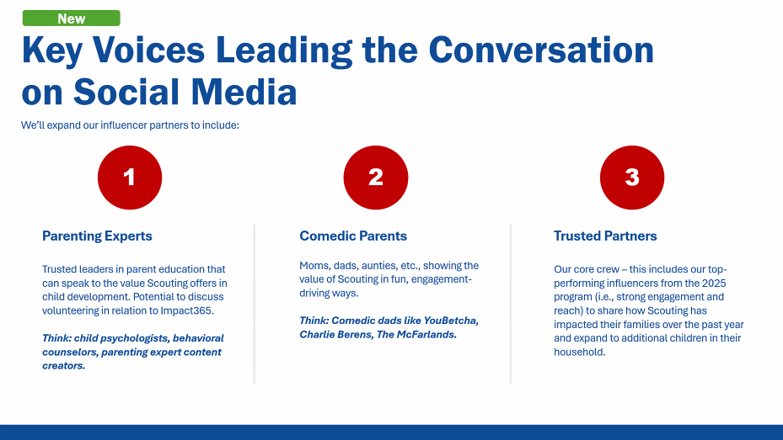
National Efforts from Scouting America

Slide 14
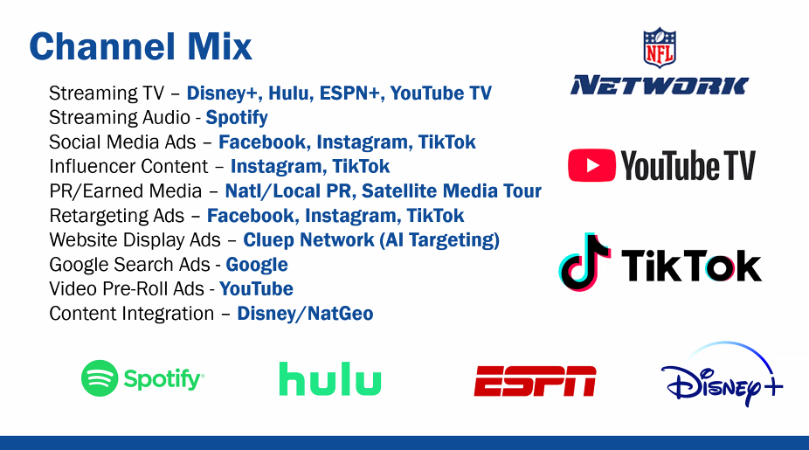
National Efforts from Scouting America

Slide 15
7 Steps for Creating Awareness & Access
Do families know Scouting exists and why it matters?
Can they find your Pack or Troop and easily get more information or sign up?
Update Your Pin
Plan your calendar through at least the rest of 2026
Complete provided templates:
  - Pack or Troop info sheet
  - Preview calendar (to copy on back)
  - Detailed calendar (doesn’t have to be perfect)
Build and maintain a social media presence
- Identify the person(s) in your unit who will be great at this.
5. Equip and encourage Scouts and families to recruit.
6. Collaborate with Council staff for school connections
7. Be visible in the community – Impact 365, America 250
Parents will want to know what they’re getting for their $ AND understand what Scouting will look like in their schedule

Slide 16
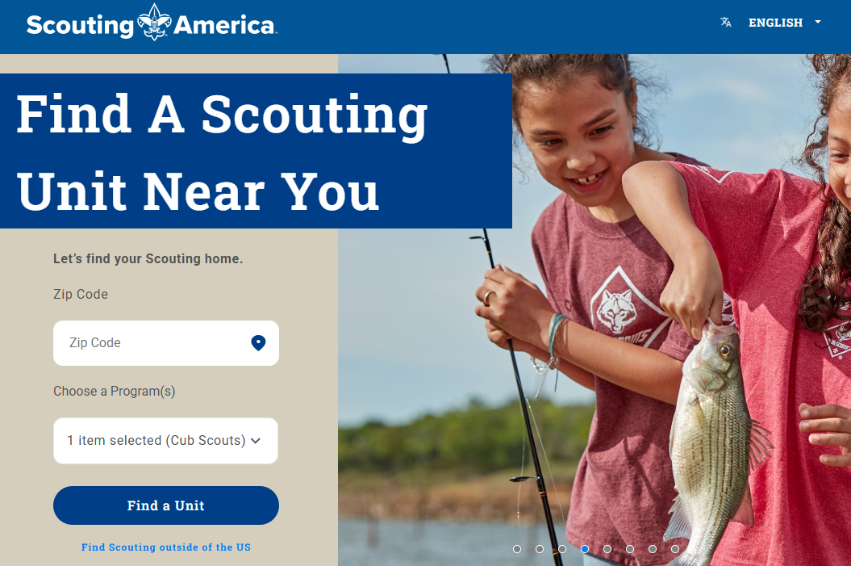
1. Update Your Pin on BeAScout.org with accurate,
helpful details
All general recruitment marketing is pointing toward your pin. If it’s not correct, you won’t get any leads.
***Who in your unit is going to respond to leads? ***
Must respond within 48 hours—ideally 24 hours.

Slide 17
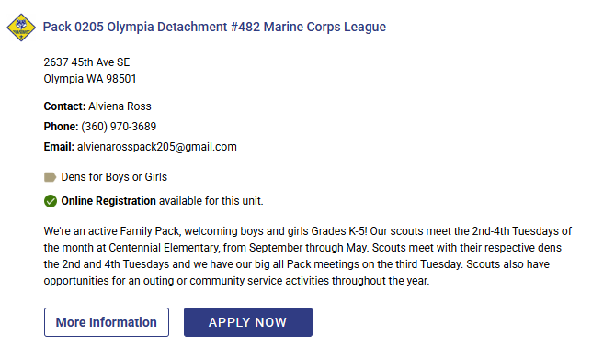
1. Update Your Pin on BeAScout.org with accurate,
helpful details
5 Ws and How: Who, What, When, Where, Why
Be descriptive and talk about activities, benefits, and fun.
Include when you meet, so if your Pack isn’t a fit, families can find another one that is.
Look at other Councils for ideas
Our Pack offers camping, hiking, and other outdoor adventures. We teach life skills through fun, safe activities, and build friendships and character along the way.

Slide 18
1. Update Your Pin on BeAScout.org with accurate,
helpful details
Tips: What’s on your Facebook “About Us” section and your Pack info sheet should match what is on your pin. Make sure it’s all consistent.
Consider a Pack universal Gmail address, rather than a specific person, with 3 Key admins + others as appropriate
15 minute webinar on YouTube on how to update Pin https://www.youtube.com/watch?v=Mtcibdbz2jI

Slide 19
2. Plan Your Calendar
Planning is the difference between an “ok” unit/program and a GREAT one
Programs! Make a calendar for (at least) the rest of 2026
    Moms really like having dates set far in advance.
    Even if it’s not perfect, share what you can
The best units have activities that naturally attract—and retain— members.
Remember this slide, and the #1 answer?

Slide 20
Biggest benefits / selling points of Scouting (“Why Scouting?”)
Both Youth and Adults:
FUN - biggest recurrent theme
Builds self confidence
(Lifelong) leadership skills
Community service
Trying new things/experiences
Outdoor adventures
Life skills
Making friends and belonging/inclusive
Quality friendships
No try-outs - everyone can participate
Career exploration
Year-round (not seasonal, like sports)
Social skills/relationships
Youth teach each other

Slide 21

Many Resources Available
New Ready, Set, Scout! Guide
(in your folder)
Council & national resources
https://www.scouting.org/programs/cub-scouts/leader-resources/
https://troopleader.scouting.org/
Other units – what’s worked for them?
M & M Committee

Slide 22
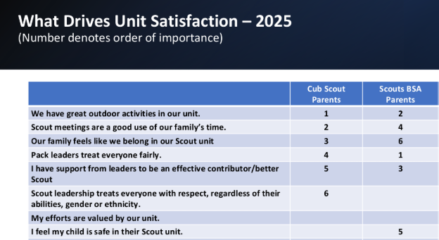
Results from most recent Voice national survey

Slide 23
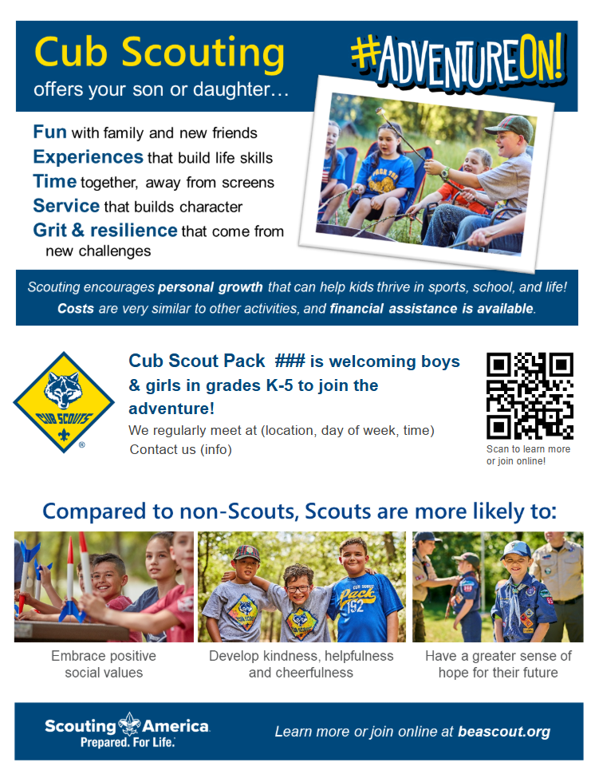
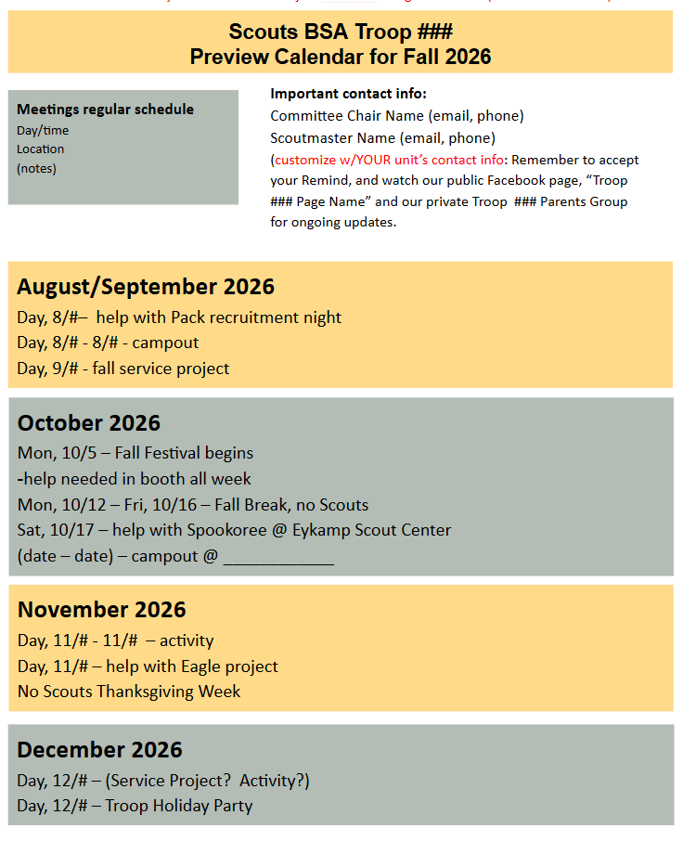
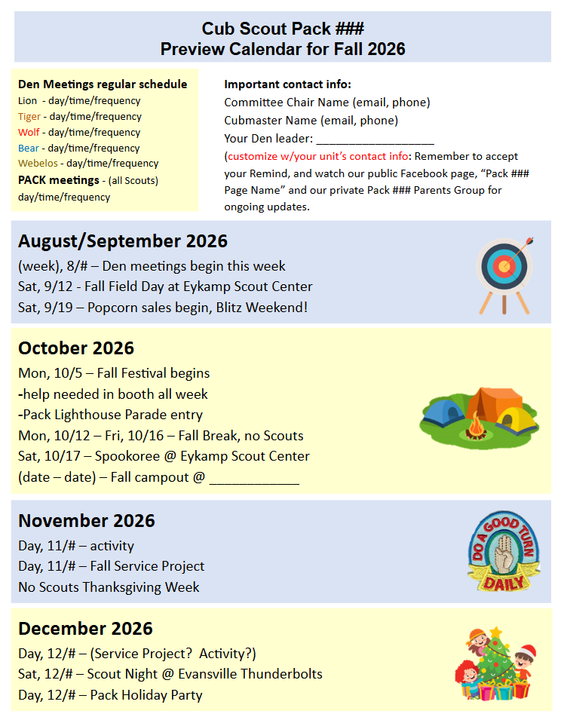
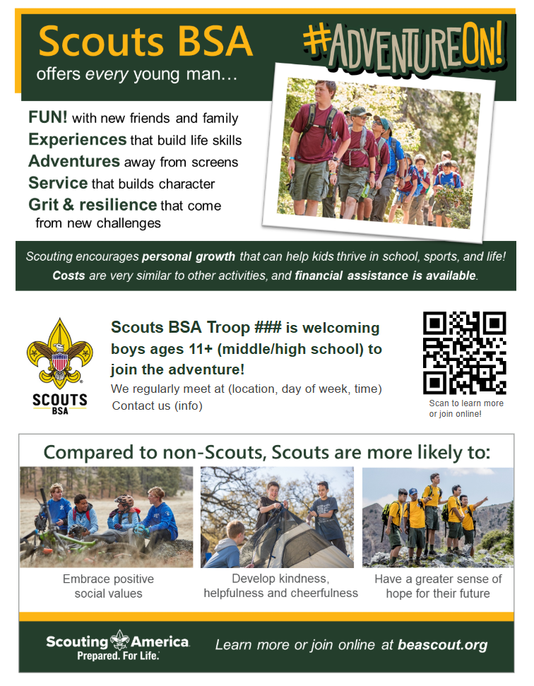
3. Complete Provided Templates: Pack (or Troop)
Info Sheet & Calendars
Something to hand out wherever and whenever needed.
Templates are ready to go!
  All you have to add is your Unit-specific information
Take copies with you everywhere, at every event!
  Make sure families have copies as well.
Feedback Shared w/ National #1 reason people join: they got a flyer

Slide 24


Info Sheet & Preview Calendar – Where to Use?
Community events
Back to school nights
Insert into church bulletins
School opportunities
  PeachJar (talk to staff first)
Backpack giveaways
Pizza boxes – do you have any contacts?
Any place you’re active in the community – have them with you)
Where else???
Yard signs and flyer boxes displayed together….Ideal at school pick-up lines

Slide 25
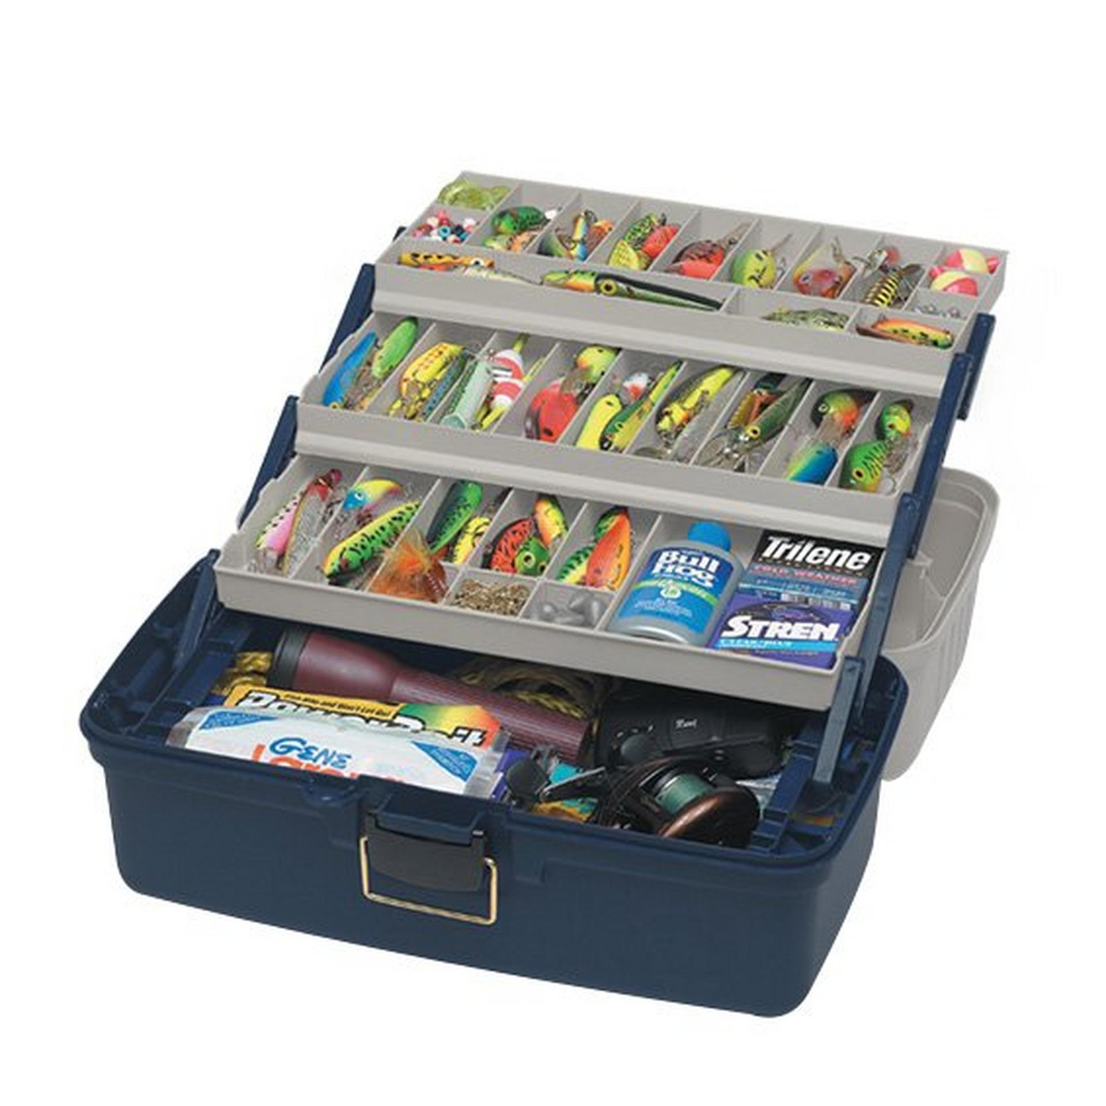
Let’s Look at Resources
Your online tacklebox!
Pending files being moved from Becca’s google drive to BTC google drive, to then create links
Add a few details
(link to page)

Slide 26



4. Build & Maintain a Social Media Presence
There is no such thing as perfect in the realm of social media.
  Perfect should not be the enemy of the good.
WHO in your Unit would be good at this?
  Cub Scouts
    Who are the parents and leaders…
      active on social media
      who demonstrate good judgement?
  Scouts BSA
    same questions, but also with Scouts themselves?
      Must be 13+
      Goal: showing their friends how much fun they’re having!
      Best ways to do this….
https://scoutingwire.org/social-media-guidelines/

Slide 27
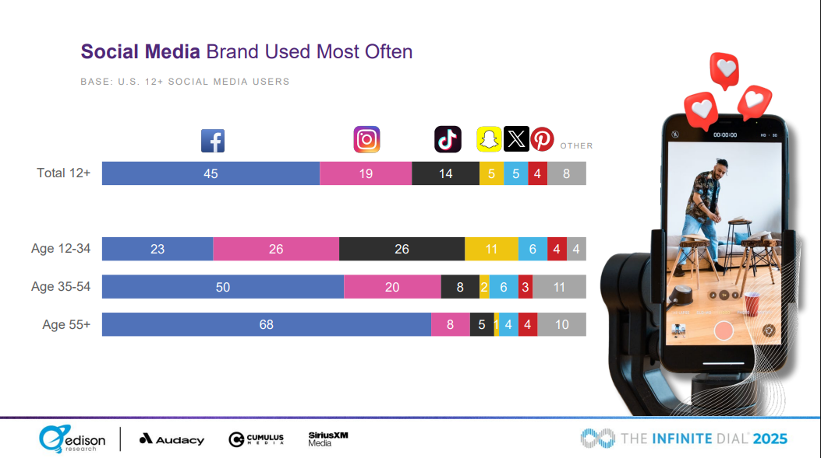
Instagram & TikTok are where the kids and young parents are.
Facebook is where many moms get info about their kids’ school, sports and other activities.

Slide 28
4. Build & Maintain a Social Media Presence (continued)
Be active. Post after as many campouts, activities
and meetings as possible.
Each post must have photos or a video.
Use an authentic voice, with enthusiasm.
Be fun and relevant! (emojis, hashtags, etc.)
Include those points about what parents care about….
Life skills, fun, safety, service, leadership, and getting
all kinds of new experiences.
When SCOUTS post… they should be showing the fun and adventure they’re having, to create some FOMO!
**Show the value of unique and varied opportunities only available in Scouting!**
Example: in June:
“How are you spending YOUR summer?”
Promote what you did at camp!
See provided posts samples on the tacklebox (recruitment page) at www.buffalotracecouncil.org

Slide 29
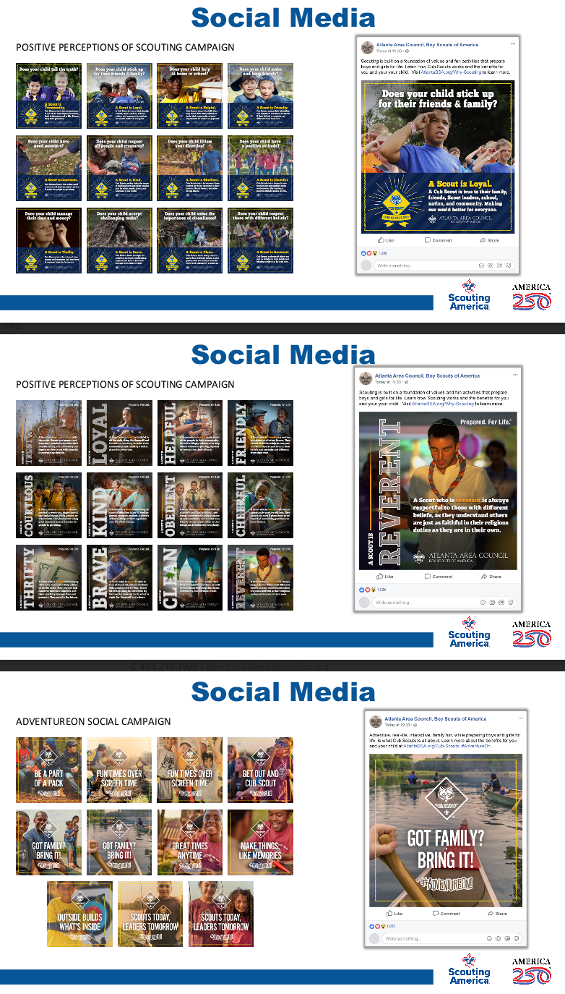

Slide 31

Scheduling & Boosting Facebook Events
Plan your details
Send the info to your Scouting professional
The Council will create, schedule, and boost your event (pay $25 to target your audience) from the Council page.
Think far ahead… The post should be up 2 weeks before the event. We want that information for other publicity, too. So aim for sending the info by July 4!

Slide 32
Back to the Tacklebox!
Review 2026 Council recruitment page - social media assets
Pending National making the assets available in Brand Center; they were not as of early May

Slide 33
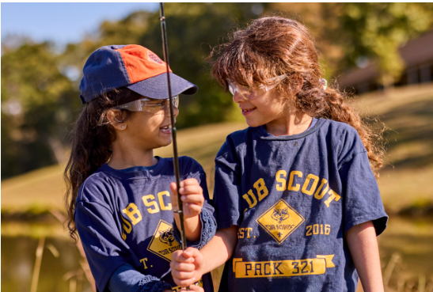
5. Equip & encourage Scouts and families to recruit
Personal invitations are the most effective method for recruiting new members into Scouting America, often described as the #1 secret to growing a Pack or Troop.
Promote your unit in general
Recruit new Scouts
Growing awareness of Scouting overall, including encouraging Scouts to look at other units (due to scheduling conflicts, proximity, etc.)
When existing Scouts invite their friends, or parents invite other families, it creates a trusted connection that leads to higher participation and retention rates.

Slide 34

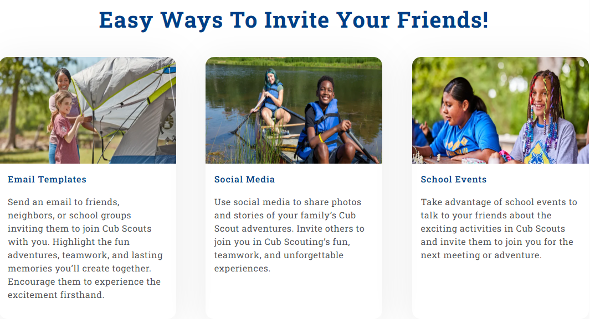
The Very First – and some may say, most important – badge Scouts can earn!
https://www.scouting.org/welcome

Slide 35
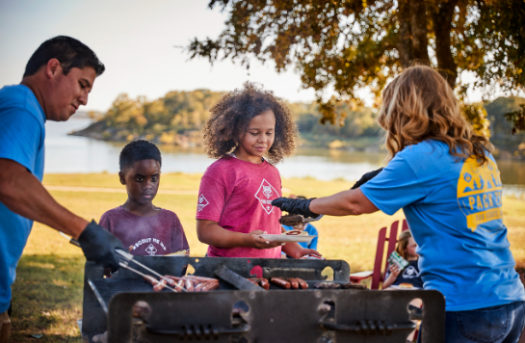
How Families/Scouts Can Invite
Inviting to Activities
  Instead of just asking someone to join, invite them to a specific, fun and engaging activity, such as a cookout at a playground, nature hike, or a special “Bring A Friend” Pack/Den meeting.
    Consider a community partner event, like cyber safety, first aid, simple gardening, behind the scenes tour, etc.
Recruitment Tools
  Utilize Council’s provided resources, including recruitment flyers and peer-to-peer cards, to make the invitation personal and informative.
Digital Outreach
  Use personalized emails, texts, or social media posts/messages to reach out to potential new members and their parents.
Follow-Up
Again…this is an ongoing process:
Recruitment is not a once-a-year event; keep the invitation open year-round, with multiple opportunities for friends and family to join.

Slide 36

How Families/Scouts Can Invite
Follow-Up Scripting Samples - For text, email, or guide for conversations
It was great to see you at _____, and I enjoyed talking to you about Cub Scouts. It’s been so great for (own child) and I would love for you to bring (name) to our next activity (what, when, where).
Congrats on (name) making the (team). I hope he/she loves it!
Scouts has been really good for (own child’s name), and it even works around the team schedule and other things on the calendar. Glad to tell you more.
I hope you and (name) had fun at (event). I’m happy to answer any questions you have about Cub Scouts. Our next (event) is coming up, and if (name) joins, he/she can start earning their awards and advancements. I can help you join, or you can do it online. Just LMK!

Slide 37

Other Invitation and Peer-to-Peer Best Practices
Equip parents with print or PDF versions of completed flyers/preview calendars
Ask parents to post on social media
  Make their own posts about what their kids have been doing (be mindful of who else is in photos)
  Share posts from Pack/Troop
For forming new Scouts BSA Troops: Another Troop acts as hosts
When you have a special recruiting event, create a Facebook event for these special events for parents to share, and target your audience. (instructions for this are on Council resource page)

Slide 38


Other Invitation and Peer-to-Peer Best Practices
Buddy “peer to peer” cards, postcards
  Send along to school, pass out at events, use in egg hunts, trick-or-treating
  Trading card (Cubs) or postcard size (Scouts BSA) (templates on Council resource page)
Incentivize Scouts for recruiting – ideas with high perceived value, no cost
  Cub/Scoutmaster or SPL/older Scout sets up recruiter’s tent
  No kitchen duty for certain # of campouts or events
IDEA!
Anyone who
brings in a buddy card or postcard they received gets
a prize!

Slide 39
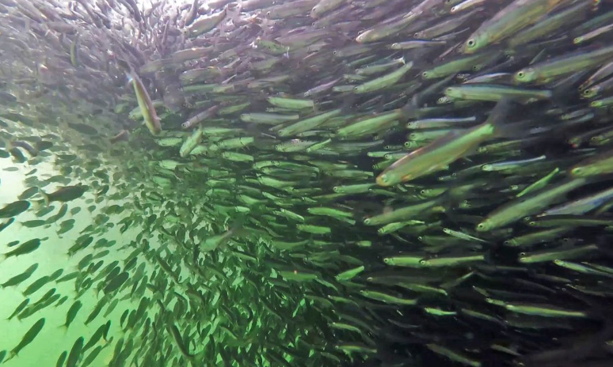
6. Collaborate with Council staff for school connections
Even within large school districts, each individual school is its own unique entity.
Current and potential relationships are often dependent on past relationships.
Contact your Scouting professional before initiating any school-specific efforts.
  Even if you have a good relationship, they want to know first.
  They may be able to recommend an additional “in” or ideas for you based on knowledge they have.
A “school” of minnows

Slide 40
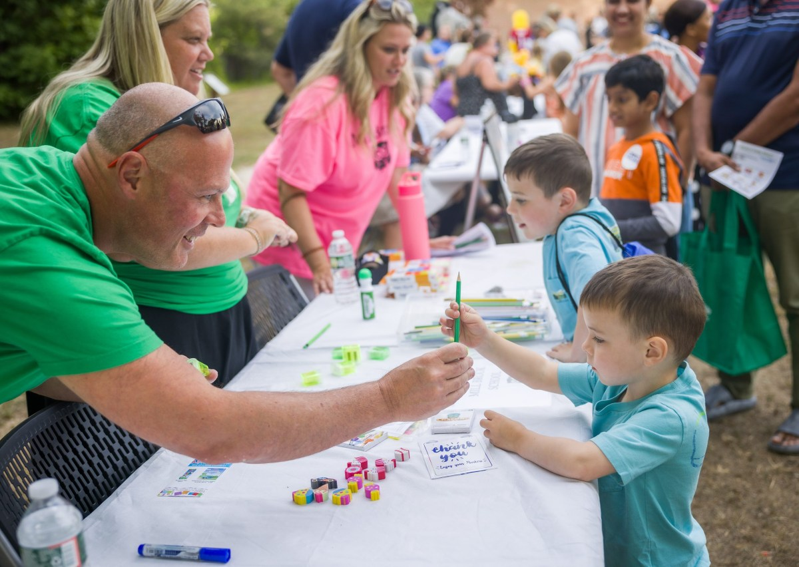
6. Collaborate with Council staff for school connections (continued)
Possible promotional opportunities
Back to school / open house / meet the teacher nights
PTA relationships
Teachers who would identify prospective members
Kindergarten round up/orientation
Middle school orientation
  Any other ideas?

Slide 41

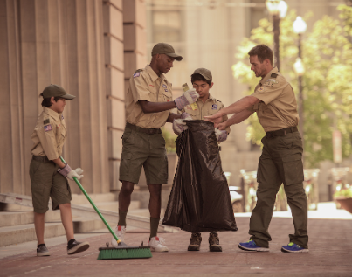
6. Collaborate with Council staff for school connections (continued)
School Service Project Ideas
Grounds beautification, clean-up landscaping
Creating pollinator or other specific gardens for classes
Help with carnivals, festivals, teacher appreciation activities
Program participation, like
STEM demonstrations
Minor maintenance, such as repainting curbs
Can evolve into Adopt-A-School
  Any other ideas?

Slide 42


7. Be visible in the community – Impact 365, America 250

Slide 43
Serve. Lead. Impact.
Impact365 builds character and strengthens communities—one Scout, one project, and one service hour at a time.
Impact365 encourages Scouts to make a positive impact 365 days a year through local, flexible, community‑driven service projects.

Slide 44
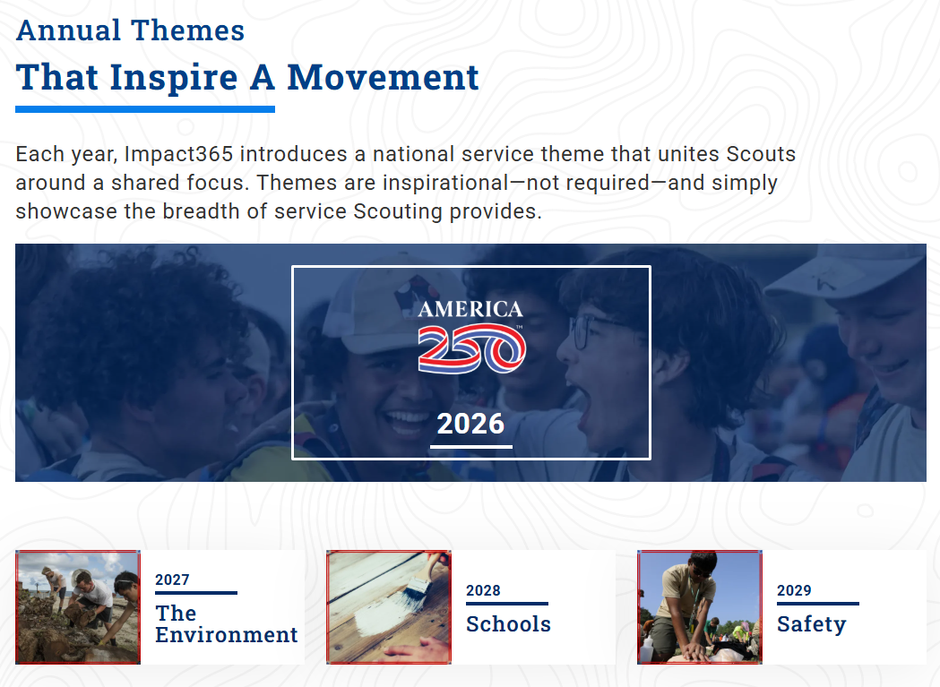
Full details at www.scouting.org/service

Slide 45
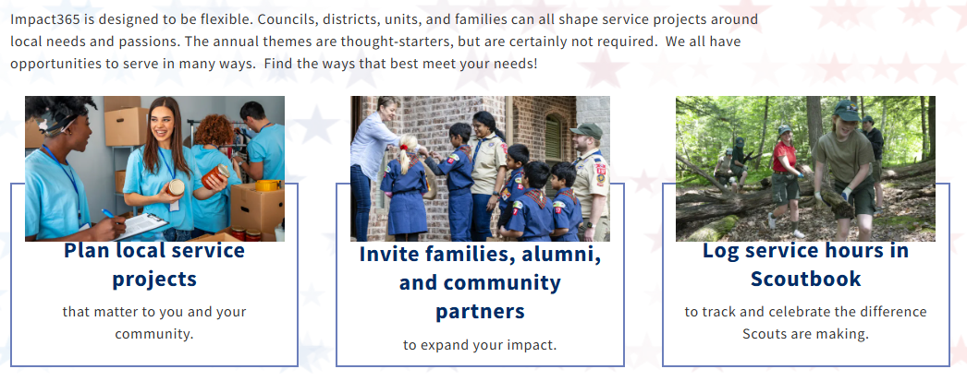
2026 Theme: Celebrating America250
  In honor of our nation’s 250th anniversary, every unit is encouraged to complete 250 hours of community service in 2026. Every hour matters. Every act strengthens a community. Every service project builds character.
Details at scouting.org/service/a250

Slide 46
What have been some of your favorite service projects, or some you’ve heard about? (list ideas below)
(Be sure to register your event in Scoutbook!)
Ensure added visibility for service projects
Post to your social media pages with lots of photos
  Tag relevant organizations/ individuals for further visibility
Send a photo to your smalltown newspaper with a brief description
  Local TV stations also have special features (WFIE Sunrise Shoutout)
What else?
101 great Scout service project ideas article: https://blog.scoutingmagazine.org/2015/10/09/101-great-scout-service-project-ideas/

Slide 47
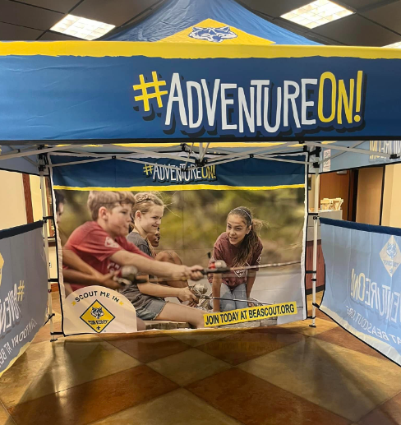
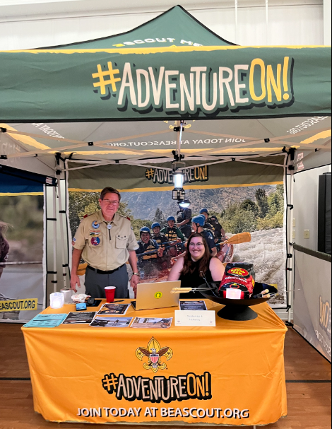
Other community visibility Ideas
Summer community events
  Farmers markets
  Festivals
  Fairs
Parades – a walking group or a float
Flag ceremonies
  Schools
  Athletic events
Other ideas?
Borrow Council equipment:
  Canopies (CS / SBSA) *not at fundraising events
  Parade banners (CS / SBSA)
  Popcorn popper
  Firepit w/s’more and pie irons
  Sphero robots
    (includes 15 robots, 15 tablets, and programs)
  Inflatable planetarium
These are in the tacklebox!

Slide 48

From Interest to Joining
Reeling Them In

Slide 49
Once They’re Interested in the Bait, How Do You Reel Them In?
MAKE IT EASY! Don’t lose them!
If registering at an event:
laptops with hot spots
paper forms – need clipboards and pens
offer to help (need plenty of adults there)
  keep the kids busy (older Scouts?)
be prepared with needed materials,
calendars, and clarity on next meeting/event.
add them to communications tools
If they registered online, be:
quick to follow-up on leads
warm, helpful, welcoming
…then connect them to all needed info and communications tools
Welcoming Ideas
Start them off with a class B shirt.
Be a unit that passes along neckerchiefs—maybe even other uniform elements.
Financial Assistance Conversations
read the room, read the faces
have a note on each clipboard
“See us if you want/need to apply for financial assistance” – then do so immediately and discreetly.

Slide 50
Conversations About Cost
$85
$80
$165
per year, per Scout
or
$13.75/month
Scouting America Annual Membership Fees:
$85 for Cub Scouts, Scouts BSA members
$65 for all adult volunteers
(covers registration costs and insurance)
$50 for Exploring participants Youth & Adult
no longer a first-time joining fee
$15/year optional Scout Life Magazine
--------------------------------------------------------------------------------------------------------
+ $80 Council Fee (youth only)
Emphasize earning that amount in 2 hours of selling popcorn, to cover fees for the year going forward
Can your unit offer payment plans?
Can your unit offer to cover all costs for adult volunteers?

Slide 51
Now that they’re excited and have signed up…what next?
  Recruitment only succeeds when it hands off cleanly to onboarding.
  This is the moment where growth either accelerates or leaks.
Retention begins the moment the family joins.
The first 30-90 days matter more than any other period in the Scouting journey, especially for new Cub Scout families, who we know drop fastest when onboarding and early experiences fall short.

Slide 52

Retention
Now that you’ve caught them, how do you keep them?

Slide 53
(Revisiting) results from most recent Voice survey… with retention in mind – what would be reasons for quitting?
Focus here is on Cub Scouts / their parents
Would expect similar rankings from new-to-Scouting families in Scouts BSA.
Most recent national survey: Why Do Cub Scouts Quit?
  30% - child not interested in meetings or activities
  28% - disorganized meetings
  18% - poor communication from leaders
Other 24%
15% - misbehaving youth
9% - leader did not work well with youth

Slide 54
National Plan:
Factors Impacting Retention Success
What works for keeping Scouts, and what works against it?
1. ONBOARDING: How families are welcomed and launched into Scouting
2. LEADER QUALITY: Single biggest driver of unit vision and success
3. PROGRAM QUALITY: What Scouts actually experience
4. ENGAGEMENT: Why families stay
5. FRICTION: The Enemy of Retaining
- Anything that makes Scouting harder than it needs to be
Notes:
Awareness: Do families know Scouting exists and why it matters?
Visibility & Service
Schools
Community
Marketing and PR efforts
Access: Can families easily say “yes”?
Units near where families live (promoting all units, not just their own)
Schools and chartered partners
Affordability
“Emerging Markets” and multicultural pathways
Invitation: Did someone personally ask them to join?
Peer-to-peer asks
New Member Coordinators
Unit Growth Executives
Parent Champions
Bring-A-Friend moments
Conversion: Did interest turn into a registered Scout?
Joining Events
BeAScout follow-up speed
Simple registration
Clear value proposition
Friction: The Enemy of Recruit/Retain
Anything that makes Scouting harder than it needs to be
Cost confusion
Poor communication
Scheduling issues

Slide 55
1. ONBOARDING: How families are welcomed and launched into Scouting
Sharing all resources and information
Give parents overview materials
  Cub Scouts/Scouts BSA in general
    Launch kits
    Helpful websites and social media
  Specific to your unit
  – see template on Council resource page
    Contact info
    Communications tools used
      Email?
      Remind/other texting?
      Facebook private group?
    Meeting information
    Calendar
    Expectations
Who will be great at doing this?
New
Member
Coordinator

Slide 56

1. ONBOARDING: How families are welcomed and launched into Scouting
New Member Coordinator
In general, all New Member Coordinators:
  Serve as welcoming ambassadors for the unit.
  Serve as point of contact for questions or concerns as needed, until other relationships are more developed.
  Build fun and excitement about the unit program and encourage youth and their families to take pride in Scouting accomplishments.
Make it simple:
Help people feel welcome and develop a sense of belonging.

Slide 57
2. LEADER QUALITY: Biggest driver of unit vision and success
Leaders should..
Be trained
Be present & engaged
Demonstrate follow-through
Be consistent
…what else?
We already mentioned that maybe your unit can pay for volunteers’ fees.
How can you help them with their training?
Scouts BSA https://www.scouting.org/program-updates/selecting-quality-leaders/
Cub Scouts https://www.scouting.org/wp-content/uploads/2018/11/510-50018-SelCubScoutLdrship_ST_FPO.pdf

Slide 58
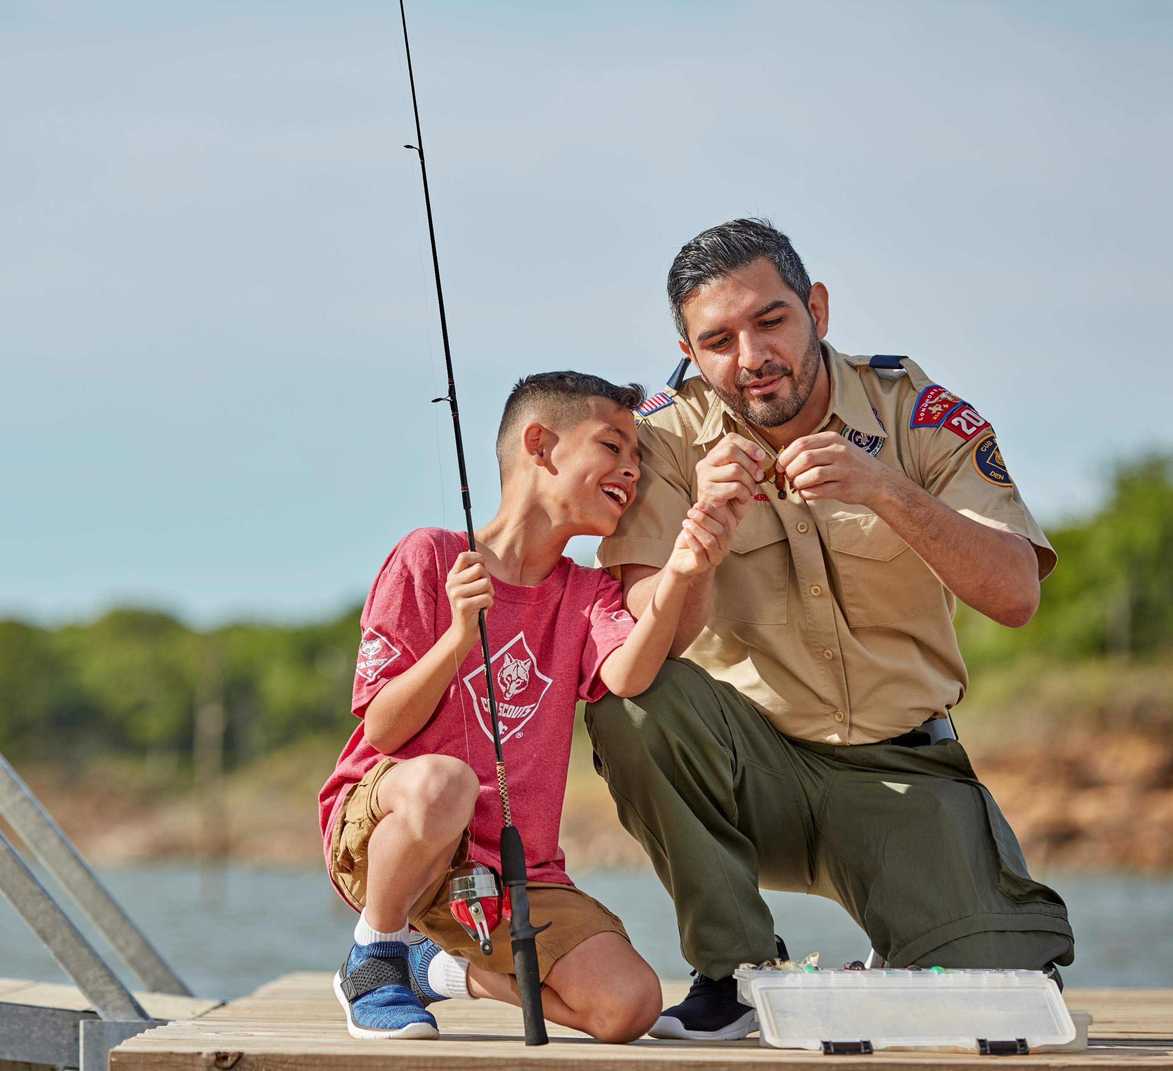
2. LEADER QUALITY: Biggest driver of unit vision and success
Engage Parent Helpers
Start small and gradually, with specific requests
  Shopping for camping food supplies, with list / quantities
  Lead a Den meeting craft or activity
  Coordinate decorations for Blue & Gold
  Help sign-in/weigh cars at Pinewood Derby
  Help kids bait hooks while fishing
  Other ideas?

Slide 59

2. LEADER QUALITY: Biggest driver of unit vision and success
How To Identify
People for Roles
What does the Parent Information Form tell you?
Did the New Member Coordinator pick up on information?
Professions:
  Bank teller – may be a good Treasurer?
  Teacher – good Den leader?
  Works at a hardware store – can help lead activities?
Other ideas?
Does someone stand out… in a good way?

Slide 60

A difficult truth…
Ineffective Pack or Troop leadership can damage the reputation of that Unit and Scouting in general.
  - Parents talk to other parents
  - Recruitment and retention for that unit –
  and others – gets so much harder
  - Remaining leaders/parents get
  frustrated/overwhelmed

Slide 61
3. PROGRAM QUALITY: What Scouts Actually Experience
Adventure and Fun, with Consistent Meetings
  First outdoor event quickly
  Ongoing things to look forward to
  Planned mtg activities with back-up leadership.
  Don’t cancel events! Need FOMO!
All comes back to…. PLANNING!
Advancement/Recognition
  Earn Bobcat quickly
  Give merit badges shortly after earning; don’t wait
  for distant CoH; include parents in presentation
Relevance
  Follow the plan!
  In Scouts BSA, units/meetings are Scout-led.
Remember, top 2
areas of satisfaction:
Outdoor activities
Meetings are a good use of family’s time

Slide 62
4. ENGAGEMENT: Why families stay – 3 main factors
Family connection – warm welcome, personal outreach
  Quality onboarding
  New Member Coordinator and others making them feel welcome
  If they miss a meeting, someone reaches out to let them know they were missed.
  Focus on early advancement – Bobcat, early ranks, and including parents in presentation
  Gradually plugging parents/caregivers into roles to build confidence and connection.
2. Communication
  Knowing what to expect (welcome packet)
  Immediate inclusion in group emails, Facebook group,
  Remind or other texting system
A sense of belonging for Scouts and families matters.
Intentional communication and inclusion efforts are essential.
3. Community and fun
  Plan on immediate impactful event
  Council Fall Fun Day in September
  Cookout / other ‘mixer’
  Have a great program planned, and then execute it!

Slide 63
5. FRICTION: The Enemy of Retaining
– Anything that makes Scouting harder than it needs to be.
Three key areas
Cost confusion - clarify, break it down, offer options
Communication & belonging – included early and completely
Culture & scheduling
Reduce friction, and retention rises automatically

Slide 64
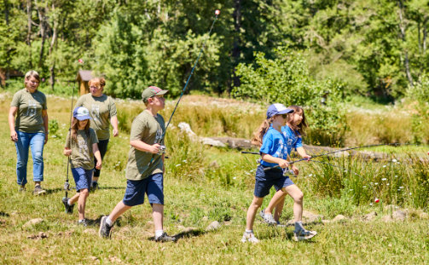
Preparing for Fall Sign-Up Night
Here they come!

Slide 65
Considerations for Sign-up Night, other Recruitment Events
Choose your date wisely!
Avoid:
  The first day of school
  Big sporting events (high school football game, for example)
  Community festivals
  Holiday weekends

Slide 66
Get Ready for Sign Up Night
At least 2 weeks before - reconfirm school or other facility use for sign up night
Confirm unit leadership coverage and support team for each scheduled location.
Be prepared, regardless of the weather for your signup night.
Arrange for table and chairs, SMALL but engaging display
  Think fun! Campfire, photos/video, etc. to draw in families
Set a recruitment GOAL, and collect contact information from EVERY family.
Print calendar and Pack/Troop info sheet
Try to set up for online registration….laptop, wifi/hotspot, etc.

Slide 67
After Sign Up Follow Up
HOW TO TURN IN FORMS (all forms should be turned in with fees to the Council office ASAP) – includes financial aid forms!
Follow up with any families who came but didn’t join RIGHT AWAY- do not let them leave without sharing their contact information.
Take immediate action steps on all online prospects/questions and applications, and emails or comments on social media sites. Waiting to take action will lose the energy and excitement for joining.

Slide 68

Preparedness Timeline
What to do this summer

Slide 69
May - June
Update your Be A Scout pin info, and make sure it matches other information. (please do in advance of large event June 19-21)
Keep families engaged—have a 1-2 fun activities this summer
Be visible! Identify service projects, festivals, parades, farmers markets, etc. to participate in this summer/early fall
Plan your fall 2026 calendar
  general dates/events—specifics can come later
  Include a school-related service project
Confirm dates for back-to-school night / recruitment events
  Let Scout Office know so we can include in promotions
Identify roles for summer/fall
  Unit leadership, including Den leaders
  Social media leads
  New Member Coordinator - Online training is available

Slide 70
July - August
Post to social media about 3 times per week.
  Use Council-provided posts and some of your own
Finalize your Unit Info Sheet and preview calendar; recommend buddy cards/postcards for Scouts to use
  Make a list of how many you need (including to Scout families)
  Contact Council office for printing
    If you have them finalized and to your Scouting professional by July 1, you can pick them up at Popcorn University on July 18
Finalize plans for fall recruitment events
  Prepare to execute it well
  Know roles for adults and Scouts at those events

Slide 71
Thank you!
Questions?
How can we help?

