Slide 1
Buffalo Trace Council
Unit/Membership Renewal
2026

Slide 2

Table of Contents
Membership Fees
  Slide 3
Membership Renewals
  Slides 4-14
Unit Renewal
  Slides 15-19
Key Notes
  Slide 20
Other Resources
  Slide 21
Contact Information
  Slide 22

Slide 3

Buffalo Trace Council
2026 Membership Fees
Families with more than two Scouts in the program will pay a maximum of $160 for the council service fee, this maximum does not include the National Registration Fee of $85 per Scout, only the $80 Council service fee. Families that qualify for the Max Family Cap, can submit this form to the council service center for reimbursement.
No family will be turned away from Scouting; the council has set aside resources to assist with registration assistance funds. To apply for registration assistance, please submit this form to the Council Service Center or Council Professional.
Thank you for your understanding regarding these important changes. If you have any questions, please contact our Council Service Center at 812-423-5246 to speak with a Council Professional.
Council Fee Q&A
Max Cap Reimbursement Request Form

Slide 4
Unit Renewal

Slide 5
How to Prepare – Unit Renewal
Check your unit’s leadership positions to ensure that the correct individuals are listed in their respective positions. If changes are needed the Chartered Organization Representative (COR) can use the “Position Manager” tool (also found in Organization Manager) to make changes. Changes will not be reflected until after an overnight refresh.
Confirm that adult leaders have current Safeguarding Youth Training (SYT). All Scouting America volunteers & participants 18+ years of age must complete Safeguarding Youth Training (formerly known as Youth Protection Training), annually.

Slide 6
Steps to Complete Unit Renewal
Validate information for the next 12-month term
1
Electronically sign the page
2
Review your Unit Pin and make necessary changes
3
Pay and submit online via eCheck or credit card or at the council office
4
Service fee may be applied at checkout

Slide 7
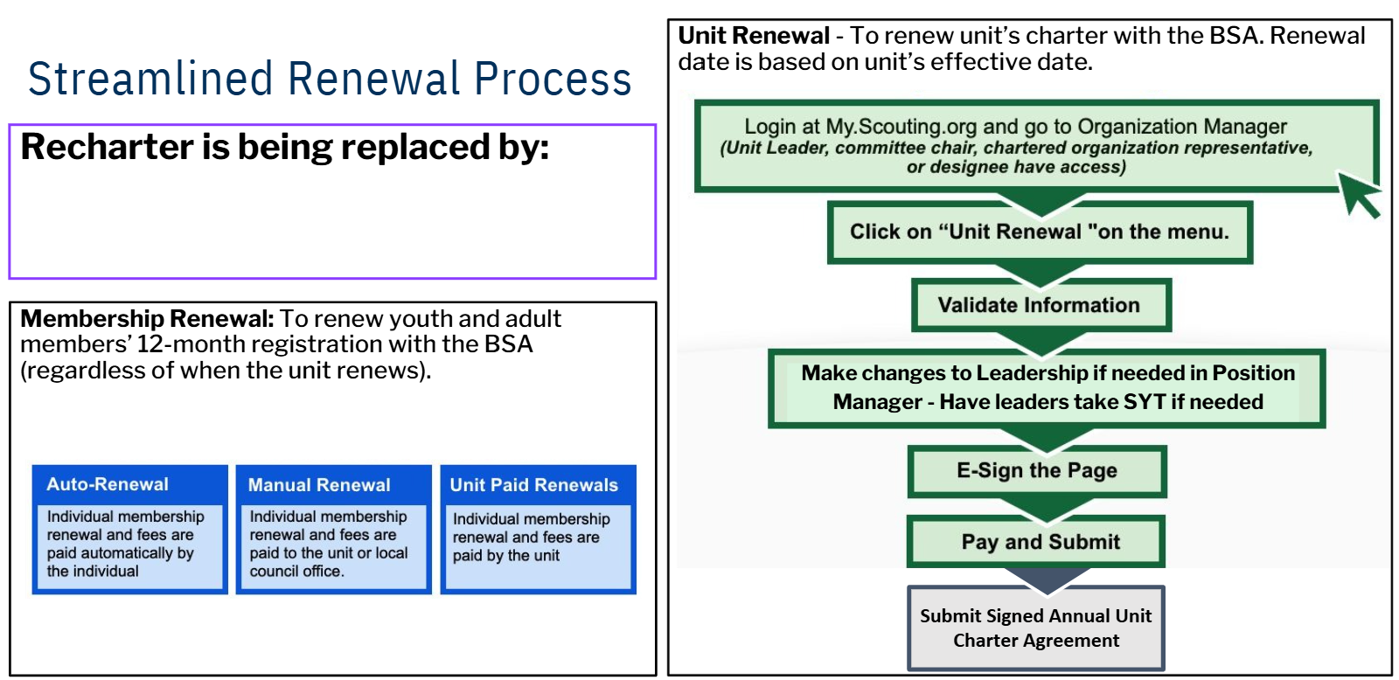
Unit Renewal - Steps

Slide 8
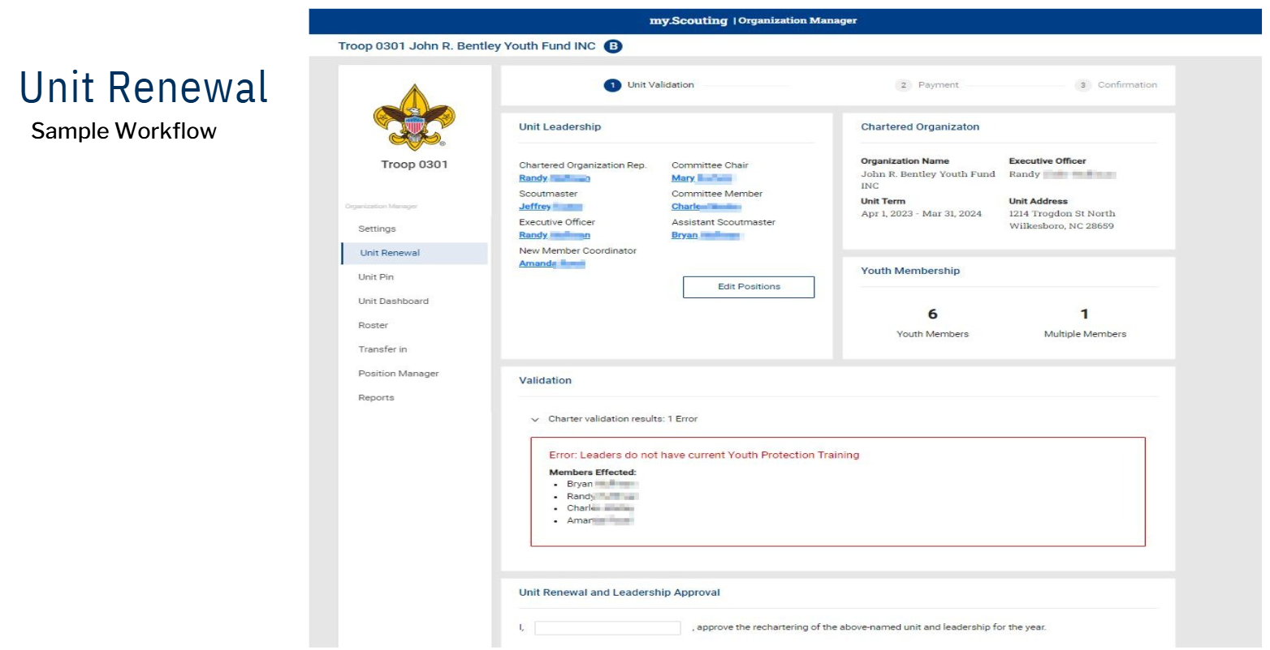
Unit Renewal – Sample Workflow

Slide 9
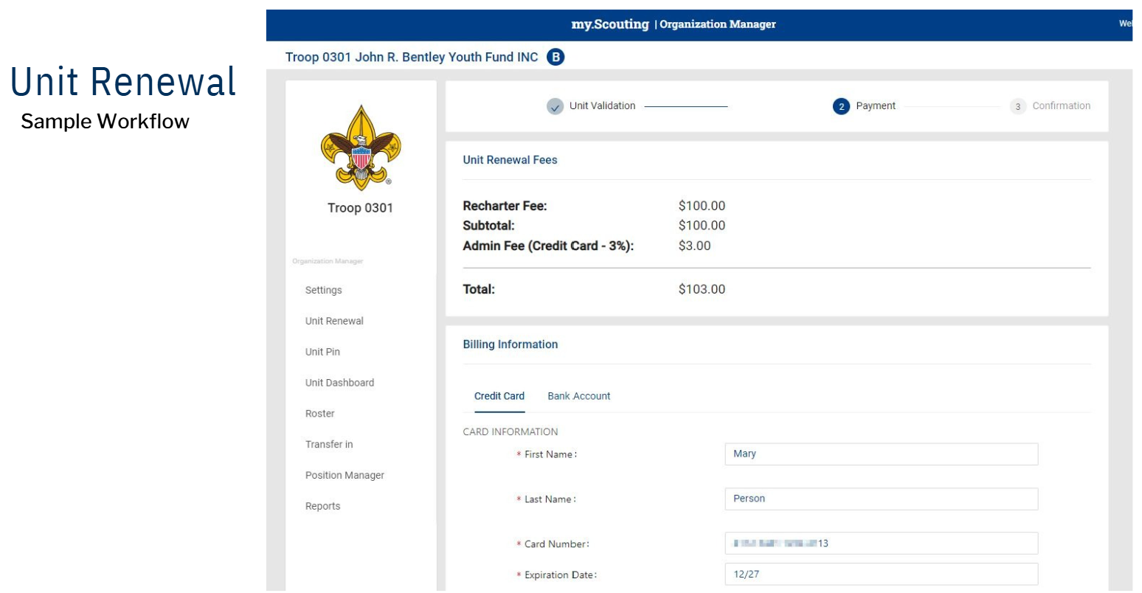
Unit Renewal – Sample Workflow

Slide 10
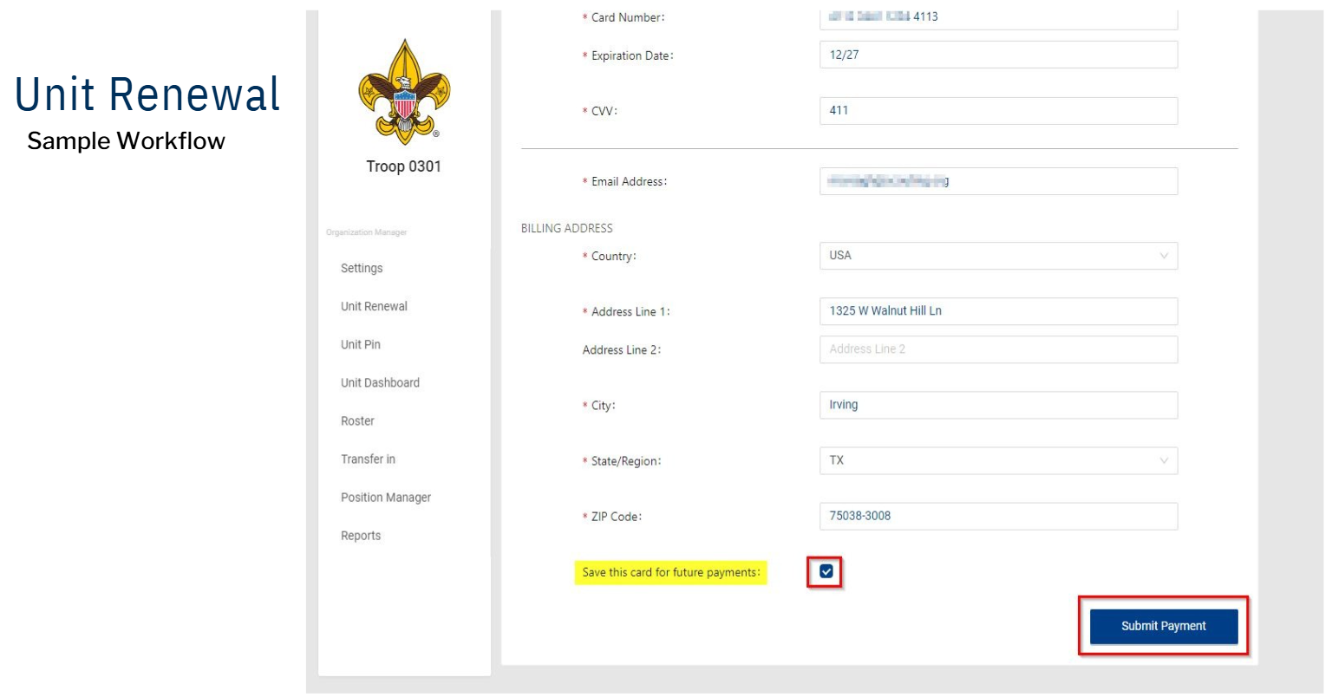
Unit Renewal – Sample Workflow

Slide 11
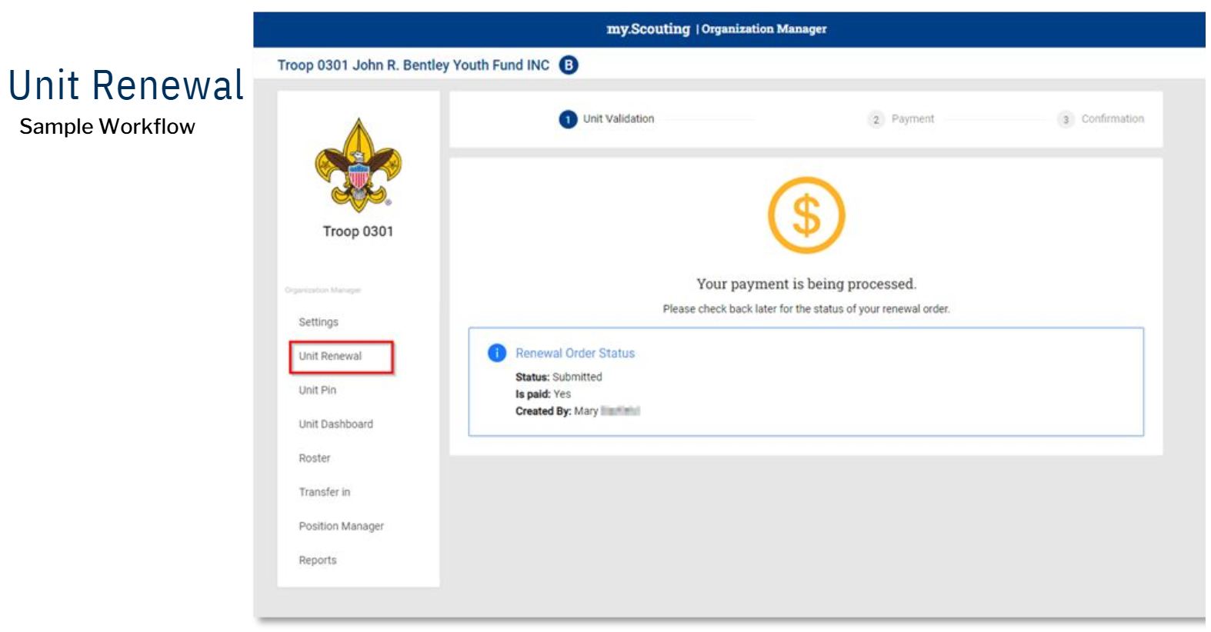
Unit Renewal – Sample Workflow

Slide 12
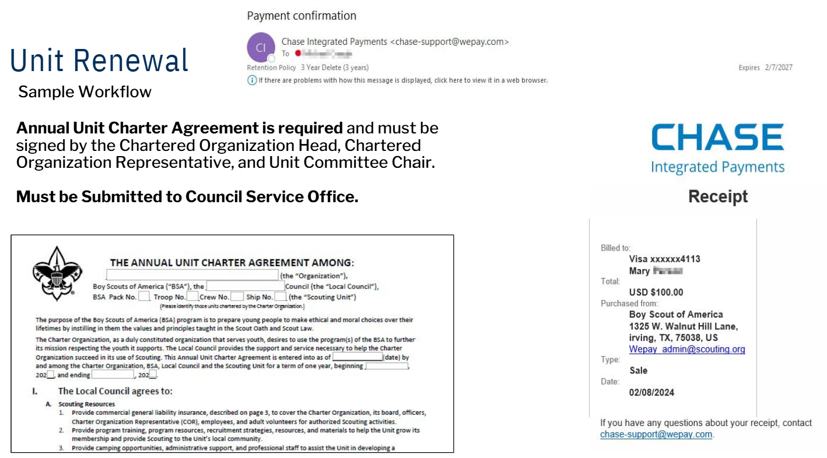
Unit Renewal – Sample Workflow

Slide 13
Submitted to Council
Only applicable to Units completed Online Renewal
Signed Charter Agreement Form
Only applicable to Units paying their Unit Renewal at Council
Unit Renewal Online Invoice
Signed Charter Agreement Form
$100 Payment

Slide 14
Membership Renewal

Slide 15
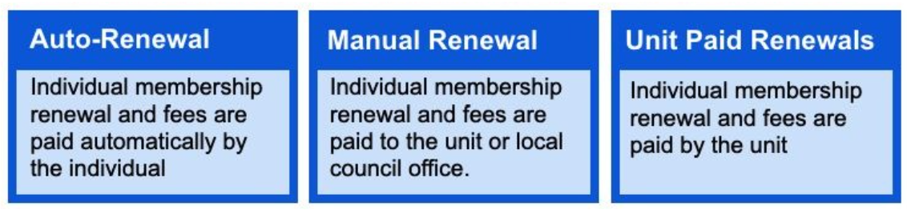
Membership Renewal
Applies to all youth and adult members of Scouting America.
All registrations are for 12 months.
Renew on the anniversary of the member’s joining date.
Membership renewal can be completed by either the individual/ family or the unit.
  Auto-Renewal – Individual membership renewal and fees are paid automatically by the individual after providing method of payment in My.scouting. Must opt-out to prevent future payments.
  Manual Renewal – Individual membership renewal and fees are paid to their unit or local council office. The unit or council receives the funds and then processes the renewal in My.scouting.
  Unit Paid Renewals – Individual membership renewal and fees are paid for by the unit using a method of payment provided by the unit. When unit opts-in to paying renewal for all members, the individual/ family will not be able to pay for their own renewal.

Slide 16
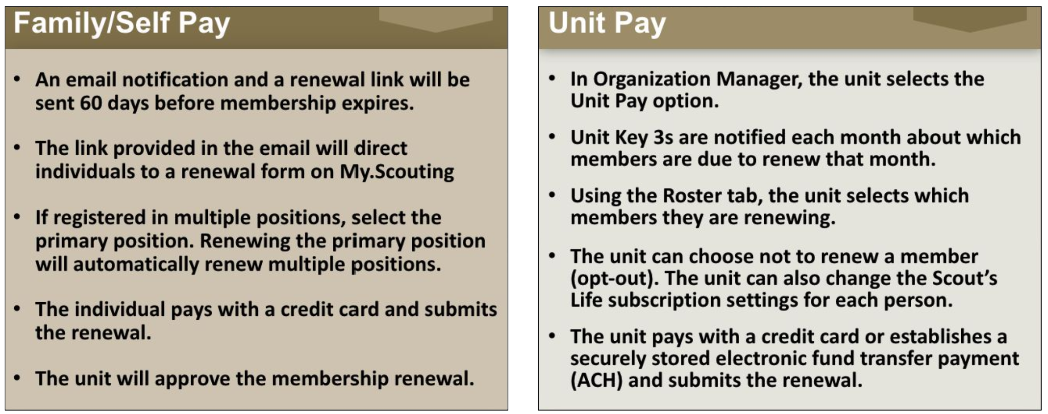
Membership Fees

Slide 17
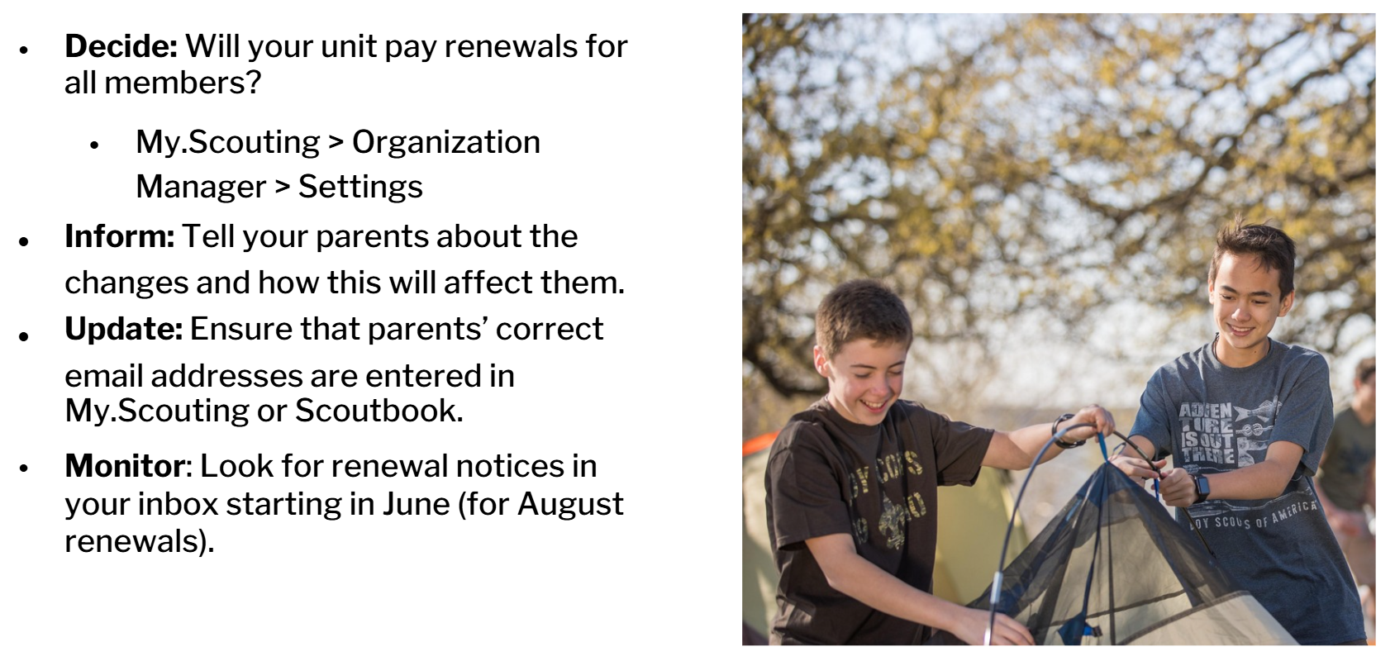
Next Steps for Units

Slide 18
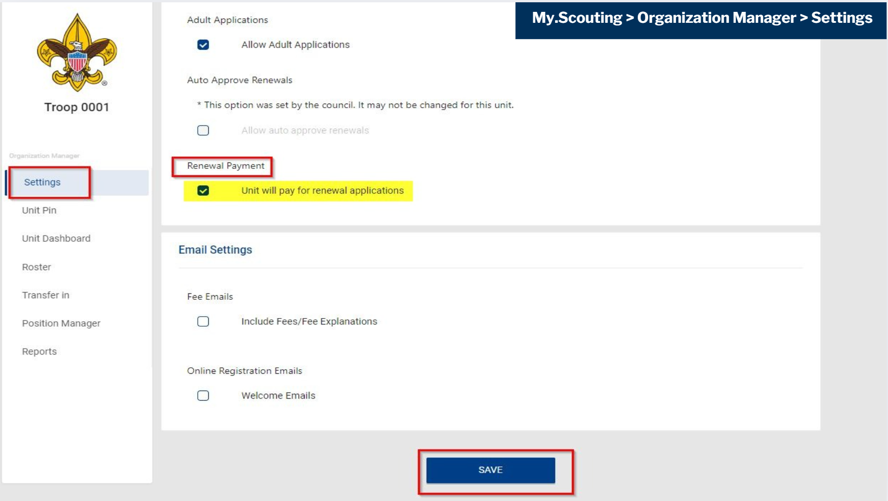
If Units Decides to Pay for Renewals
How to make changes in your unit profile

Slide 19
Key Notes
Unit & Membership Renewals
The streamlined renewal process is now live! Units can renew charters, and individuals can renew memberships. They are no longer linked.
Unit Renewal is due February 28, 2026
Council Fees
A friendly reminder that an additional Council Fee of $80, effective January 1, 2026, to all new and renewing youth membership.

Slide 20

Other Resources
Council Fee Q&A
Annual Charter Agreement
Council Fee Max Family Cap Reimbursement Request Form
Assistance Application
Membership Infographic
One-Page Unit Renewal Steps
One-Page Membership Renewal Steps
Council Website
National Website
Notes:
Add link to each item

Slide 21
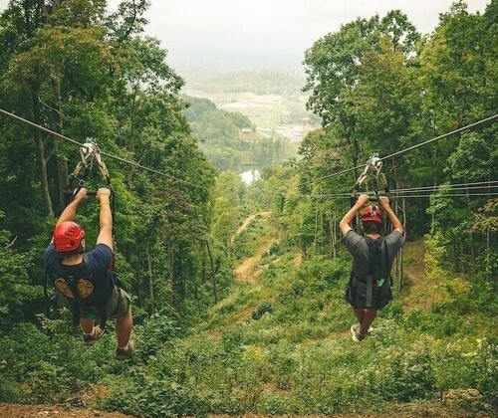
Contact Information
Council Professionals Emails
Jennifer Carapia
  Jennifer.carapia@scouting.org
Greg Hager
  Gregory.hager@scouting.org
Ryan Abbott
  Ryan.abbott@scouting.org
John Harding
  John.harding@scouting.org

Slide 22


