Slide 1
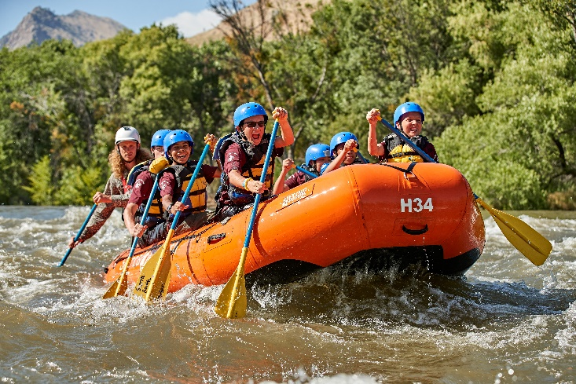
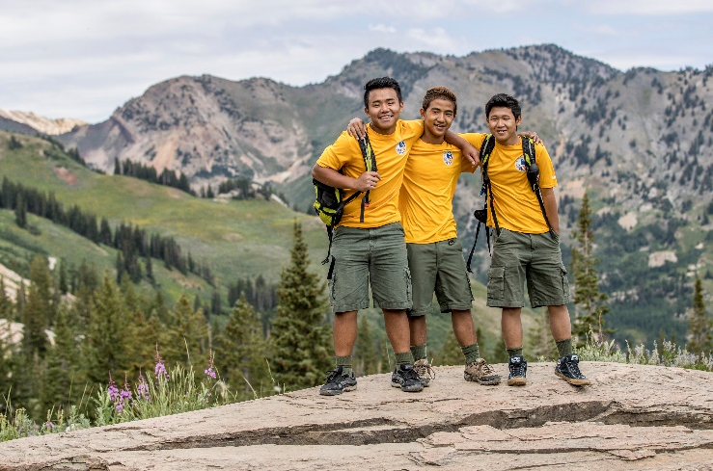
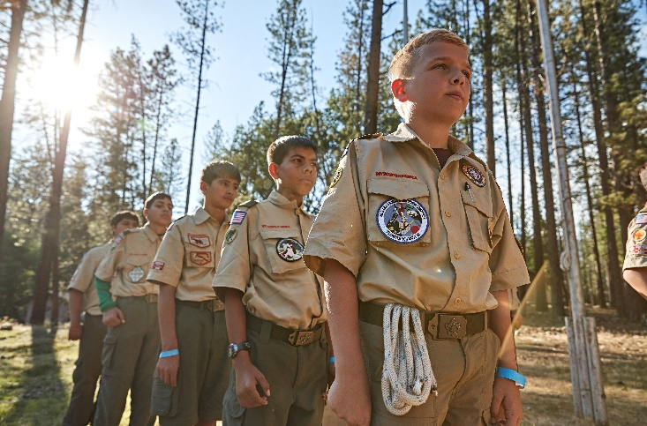
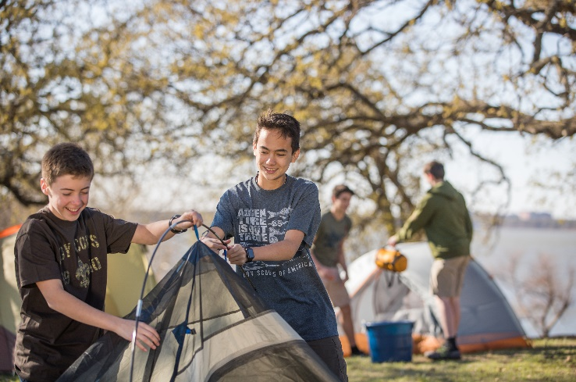
Troop ### welcoming boys ages 11 (5th grade) through 17
Scouts BSA is about…
Learning - Life Skills - Leadership
Resilience - Character
Adventure & Unique Experiences
Find us on Facebook
We regularly meet at (location, day of week, time)
QR Code to Facebook page

