Slide 1
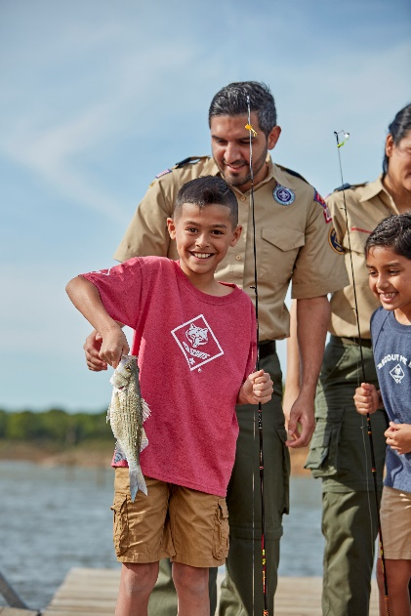
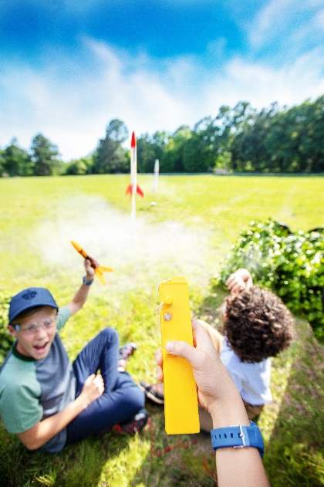
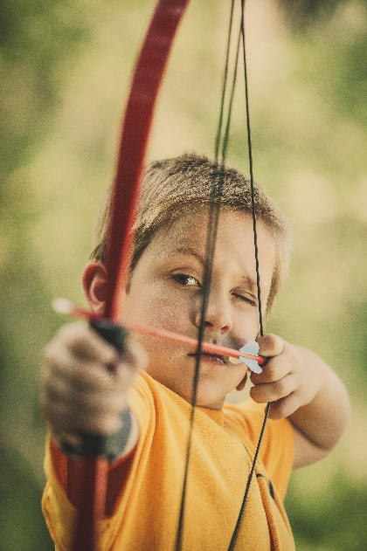
Pack ###
welcoming boys grades K-5
Cub Scouts is about… Learning - Life Skills - Character & Service - Making Friends
Adventure & Unique Experiences - Family Fun
For more information:
Name email@email.com and/or mobile
QR Code to Facebook page
We regularly meet at (location, day of week, time)
Find us on Facebook
Scouting complements other activities, helping kids thrive in sports, school and more.
Costs are very similar to other kids’ programming, and financial assistance is available through Friends of Scouting.
Scouting is an activity for the entire family to enjoy together, helping you make the most of the time you have with your children while they’re young.

