Slide 1
Revving UP to Recruit! Recruiting new Cub Scouts & Scouts BSA members to join your Pack or Troop Summer 2023 Presented by members of the Marketing and Membership Committees, Buffalo Trace Council

Slide 2
Session Objectives
Understand who you are trying to reach
Get new ideas and methods for reaching them
How to best focus your efforts
Before you leave…
We will ask you to share THREE new actionable ideas that you’ll be taking back to your unit.

Slide 3
Brief Introductions
Name, role, unit, number of Scouts
What you’re hoping to learn, and/or accomplish with what you learn

Slide 4
What do marketing and comedy have in common?
You must know your audience.
Who are you trying to reach?
What do they need to know?
What do they care about?
Invest your efforts wisely for best outcomes.
Inclusion of Scouts BSA is new in this presentation. Why?

Slide 5
So….who is our target audience?
Moms or dads?
Primarily trying to reach moms. They have the final say.
Dads are heavy influencers, though!
Moms make most decisions for households.
We also must focus our efforts on Millennials.
Who are Millennials?

Slide 6
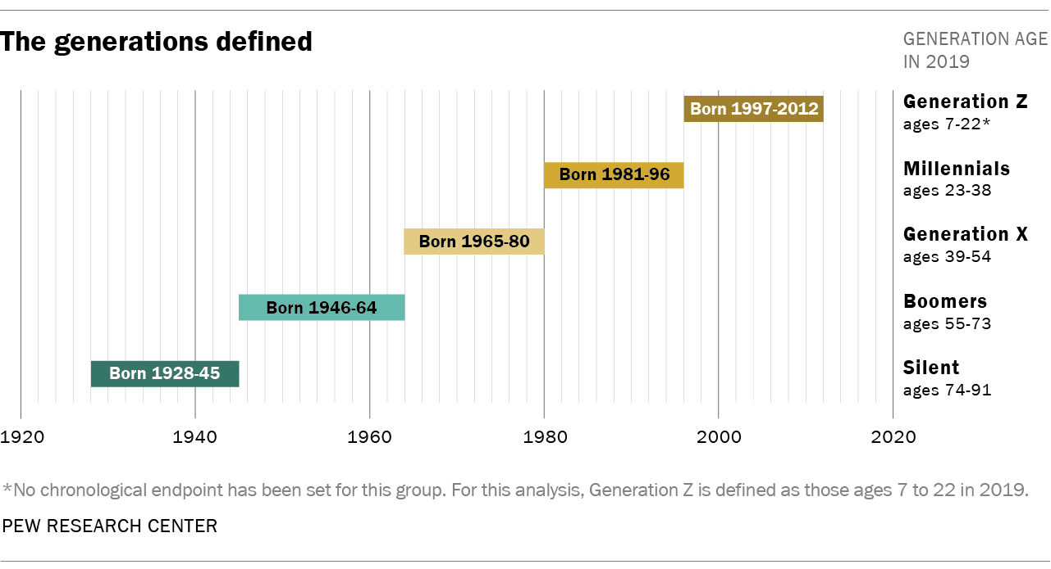
Millennials - born 1981 - 1996
11-26
27- 42
43-58
Cub Scouts are ages 5-11. Scouts BSA we’re targeting are 12-14. Millennials are their parents.

Slide 7
Millennial Moms defined
Makes about 80-85% of decisions for what her kids will be involved in.
“I’m a busy mom who worries about her kids being under pressure and not having time to just be a kid. They are growing up so fast…. I’m looking for things we can do together before they no longer want to spend time with me.”
A Cub Scout/Scouts BSA age mom is….
Between 30ish and 40ish.
A bit skeptical. She questions marketing and will search the web and social media to validate info.
Spread thin, so she needs you to make things easy.
She worries about their kids. Social unrest has only made it worse.
Doesn’t typically have a relationship with Scouting in her family.

Slide 8
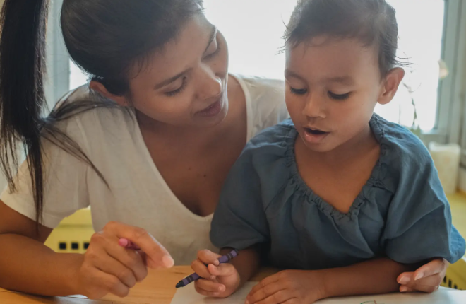
Millennial Parents Want To Raise Prepared Children…
Want to give children whatever they need to grow up and find a stable future in an increasingly unpredictable world.
Want children’s education to help them be prepared, in terms of life-skills and academics, in a future they can’t quite define.
Creativity, well-being, resilience and a sense of purpose are top of the list of skills they want their child to develop.
Skills such as flexibility, managing conflict and basic life skills were cited more than profession or subject mastery when parents were asked to think about what their children would need in the future.

Slide 9
… and want to experience activities with their child
Technology, innovation, and participatory experience play considerable roles in keeping the attention of this group.
Millennial parents expect to be full participants in their family’s entertainment and experiences.
This generational shift indicates the need to focus on providing fun, engaging experiences for the whole family to enjoy together.
Millennial parents take on a more involved, less hierarchical role with their kids than previous generations.

Slide 10
Millennial Media Facts
35% of millennials say user-generated content feels more authentic.
A staggering 90% of people that are part of this age group feel authentic marketing is much more convincing than seeing the standard commercials on television and radio.
Only two out of ten millennials enjoy watching traditional television.
Millennials prefer internet videos to traditional television. 35% of those surveyed said they prefer watching videos on YouTube, with only 19% favoring traditional television.

Slide 11
Some “Whys” for Social Media presence & marketing

Slide 12
% OF MOMS WHO CURRENTLY EVER USE EACH SOCIAL NETWORKING SITE OR SERVICE

Slide 13
Think Like A Marketer
If you keep doing what you’ve always done, you’ll keep getting what you’ve always got.
Can’t do the same things over and over and expect a different outcome.
WIIFM: What’s In It For Me?
Messaging Matters: always be answering the subtle/underlying question: “What’s in it for me (my child)?”

Slide 14
Post-Pandemic Opportunities
- What Scouting offers: everyone participates resiliency - life skills - character & values - fun respect for nature - leadership training - service outdoor experiences/adventures …like no other youth-serving organization
- Sense of community so many are missing
Activities together as a family
parents can be with kids, vs. many other activities
safety subtext

Slide 15
What You Need To Do – 6 Things
Build and maintain a Facebook presence
Create & use a unit (Pack or Troop) info flyer
Plan ahead to create a calendar to share
Schedule recruitment event(s)
Collaborate with your DE for school connections
Be visible
Resources on www.buffalotracecouncil.org

Slide 16
Be Prepared! (it’s what we do, right?) - The Ps of Recruiting
Programs!
Make a calendar for the rest of 2023
Planning is the difference between an “ok” unit/program and a GREAT one
Moms really like having dates set far in advance.
Even if it’s not perfect, share what you can
The best units have activities that naturally attract more members.

Slide 17
Next P: Pack (or Troop) Info Sheet
You need to have something to hand out wherever and whenever needed.
Should include:
Photo(s)
QR code to your Facebook page
5 W’s – who, what, when, where, why
Special activities
i.e. are there things your unit is known for?
Take copies with you everywhere! Make sure families have copies as well.
Yard signs and flyer boxes displayed together….Ideal at school pick-up lines

Slide 18
Next P: POST to Facebook
You need to tell your Pack’s/Troop’s story.
Parents who are interested in your Pack will absolutely look you up on Facebook to learn more about you.
All parents and family members like to see photos of kids having a great time. They also will share your posts.
Public page for only three things:
Sharing activities (photos/summary) AFTER they take place.
Other posts about Scouting (overall)
Recruitment events, other public events
Private group for Pack/Troop communications

Slide 19
What, When & How to Post
Be active. Post after as many campouts, activities and meetings as possible.
Each post must have photos or a video.
Use an authentic voice, with enthusiasm.
Use emojis, hashtags, etc. Be fun and relevant!
Include those points about what parents care about…. Life skills, fun, safety, service, leadership, and getting all kinds of new experiences.
See provided posts at www.buffalotracecouncil.org

Slide 20
Join some Facebook groups
https://www.facebook.com/groups/momsofevansville
https://www.facebook.com/groups/EvansvilleINAreaHomeschoolers
What's Happening Evansville, IN?
Moms of Newburgh
Fun For Families Dubois County
Parents of Gibson County

Slide 21
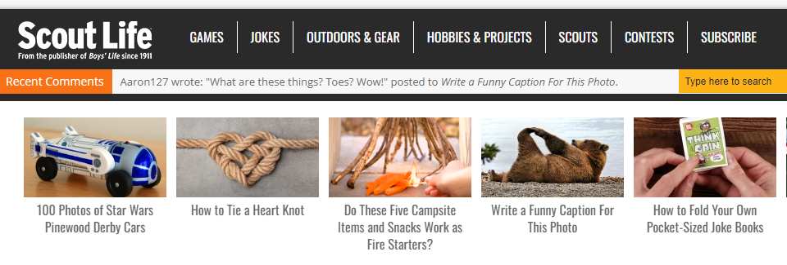
Other content to post: articles from…
Aaron on Scouting/ Scouting Magazine
https://blog.scoutingmagazine.org
Scout Life
https://scoutlife.org/

Slide 22
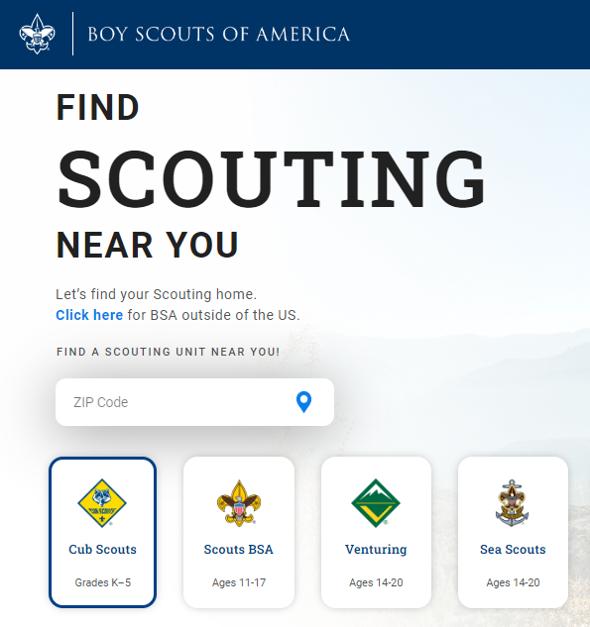
Next P: Your PIN must be accurate
Is your pin information correct at beascout.org?
All general recruitment marketing is pointing toward your pin. If it’s not correct, you won’t get any leads.
What’s on your Facebook “About Us” section and your Pack info sheet should match what is on your pin. Make sure it’s all consistent.

Slide 23
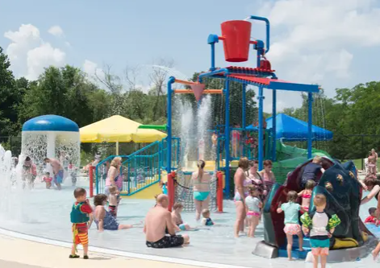
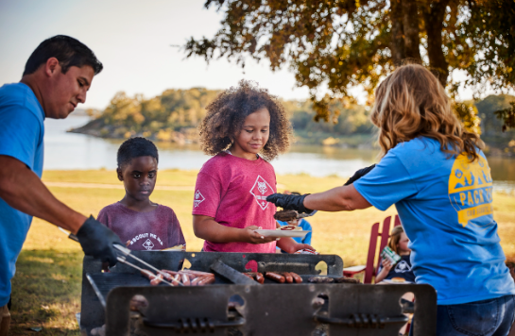
Next P: Plan Recruitment Events
NFAs – “normal friend activities”
Personal invitation, families feel included and welcome
Ideas/examples
Cookout in regular clothes, working on cooking skills
Swimming parties, playground event, story time at the library (uniforms and relevant crafts)
For forming new Scouts BSA Girl Troops: Other girl Troop acts as hosts, for testimonials
Special open house at your unit, or other sign-up night in coordination with Council.
***Create Facebook event for all recruitment events, and target your audience.***

Slide 24
Next P: Prepare Scouts & Families to Promote
For promoting your unit in general
For recruiting new Scouts
For growing awareness of Scouting
Recent Scouting research tells us: 59.3% joined because of a personal recommendation from someone they know.
Similar percentage heard about Scouting at school.

Slide 25
Additional ideas
Buddy “peer to peer” cards, postcards
Send along to school, pass out at events, use in egg hunts, trick-or-treating
Trading card (Cubs) or postcard size (Scouts BSA)
Special invitation letter
Add Pack/Troop info sheet and send in the mail
Sources of addresses
Can be particularly helpful for Den-specific recruiting
Recruiting at CO or other church

Slide 26
Additional ideas
Be present & visible, with engaging activities
Back-to-school nights, open houses
Have a fun display, hold the doors, etc.
Community events this summer
Farmers markets, festivals, etc.
Volunteer – do flag ceremonies, service projects

Slide 27
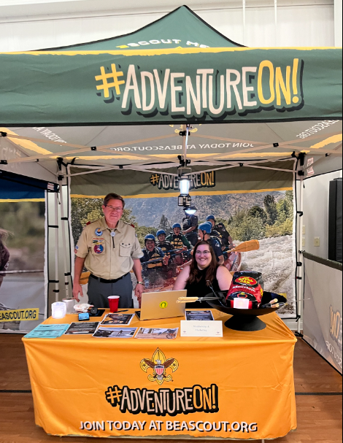
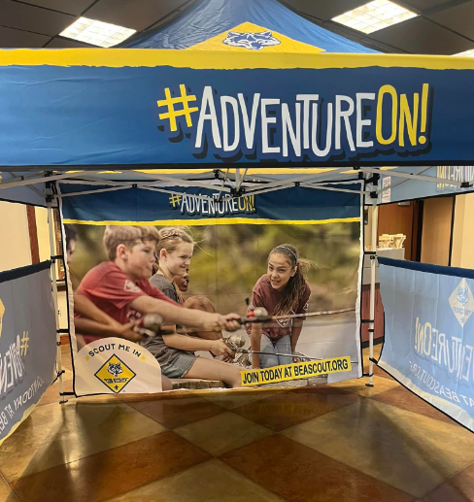
Available on loan from the council service center and units can purchase them directly from Colormax in Evansville:
https://colormaxdigital.com/product/scout-products/

Slide 28
Whenever you can…. ASK
Ask if your unit can participate or be involved
Ask how people heard about us… really helps with effective marketing

Slide 29
Other training, resources
Council Marketing Committee has provided resources… sample social media content, and templates for Pack info sheets, calendars and more on www.buffalotracecouncil.org
National Resources
www.scouting.org/recruitment
BSA Brand Center:
https://scouting.webdamdb.com/bp/#/
Marketing & Membership Hub
https://scoutingwire.org/marketing-and-membership-hub/
Marketing Webinars
https://scoutingwire.org/marketing-and-membership-hub/marketing-webinars/
Pack & Den Recruiting
https://scoutingwire.org/marketing-and-membership-hub/unit-recruiting/

Slide 30
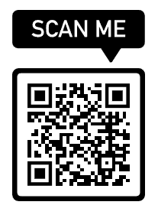
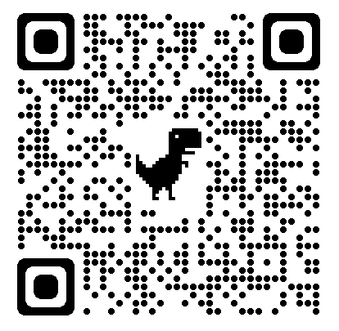
How-To Section: Creating QR Codes
Create QR code to use to promote event – use it on EVERYTHING
Flyers
buddy cards
yard signs, etc
(Ideas?)
https://support.google.com/chrome/answer/9979877?hl=en&co=GENIE.Platform%3DDesktop
https://www.qr-code-generator.com/

Slide 31
Facebook How-Tos
Creating a Facebook page for your Pack/Troop
https://www.facebook.com/help/135275340210354/?helpref=hc_fnav
How to create an event on Facebook
https://www.facebook.com/help/572885262883136/?helpref=hc_fnav
How to boost a Facebook event or post (such as your recruitment event!)
https://www.facebook.com/business/help/347839548598012?id=352109282177656 *100% match of your boost (up to $25) from Council!
How to schedule Facebook posts (Did you know you can create and schedule your entire set of Facebook posts at once? Spend some time planning and scheduling posts and they’ll happen automatically!)
https://www.facebook.com/help/1533298140275888/?helpref=hc_fnav

Slide 32
Sign Up Nights Weeks 1, 2, and 3
Generally, Recruitment Nights will be:
August 24, 2023
August 31, 2023
September 7, 2023
District Executives will coordinate these dates with individual Packs, some of which would coincide with and then follow school-driven Open House nights

Slide 33
Complete This Form
We need to make sure every Pack is recruiting at a school location.
Information will help us direct families to Packs with meetings that work for their schedule if yours does NOT
We need extra help!

Slide 34
Countdown…3, 2, 1
Calendar—Plan your dates, and stick to them. You can worry about details later
Leader contact information—On the back of your calendar (Less paper to keep track of…)
Recruit your volunteers to help… We need more help!
Find out your Open House/Meet the Teacher/ Back to School Bash dates

Slide 35
Changes to Council Marketing Material
Council will provide:
Fliers for those who allow distribution
Electronic fliers for schools
Posters
School Talks
Social media posts, ready to plug and post.
Yard signs; flyer boxes available for purchase
We will also email you weekly checklists of things that need to be done, starting in late July

Slide 36
Get Ready for Sign Up Night
The week before—reconfirm school or other facility use for sign up night
Confirm unit leadership coverage and support team for each scheduled location
Arrange for table and chairs, SMALL display
Set a recruitment GOAL
Print calendar and Pack/Troop info sheet
Try to set up for online registration….laptop, wifi/hotspot, etc.

Slide 37
Night of Sign Up
Council packets will include
youth applications
parent guides
sign in/ payment sheet
registration financial assistance forms
volunteer information sheets
“how you heard about us” short surveys
Bring pens, calendar (HIGHLIGHT ORIENTATION MEETING) & Contact information
Change for fees (you will collect the annual fee and the joining fee, prorated fees are no longer being collected.)

Slide 38
Night of Sign Up
Please note, online applications will pay registration fee (and new member fee – if applicable) for exact date of sign up, not a pro rated fee.
Ask each family “how did you hear about our sign-up night?” Jot down notes and send them to your district professional.
Don’t forget about promoting Cub Scout Fun Day…. Our first outdoor event opportunity for new Scouts
Troops & Crews should HELP PACKS! (greet new families, entertain the new recruits…)

Slide 39
After Sign Up Follow Up
HOW TO TURN IN FORMS (all forms should be turned in with fees to ….)
Follow up with any families who came but didn’t join RIGHT AWAY
Have your New Parent Orientation the next week!
We want to keep our families in our program.

Slide 40
What Drives Recommendation – 2022 (Number denotes order of importance)
What brought them in the door?
 | Cub Scout Parents | Scouts BSA Parents | Scouts BSA Youth 14+ | Unit Volunteers
Scouting is really fun for me. | 1 | 3 | 1 | 3
Scouting is a great value for the money. | 2 | 4 |  | 4
Being in Scouting makes me feel like I am part of something bigger than myself. | 3 | 5 | 3 | 2
Scout meetings are a good use of our family’s time. | 4 | 8 | 4 | 6
Scouting is our partner in providing positive youth programs to meet our goals. | 5 | 2
Scouting is constantly reinforcing worthwhile values. | 6 | 1 | 2 | 1
Our family/I feel like we belong in our Scout unit. | 7 | 7 |  | 10
I feel my child is safe in their Scout unit. | 8 | 6
We have great outdoor activities in my troop. |  | 9 | 5 | 8
I feel the council/district is very responsive to my needs. |  |  |  | 5
My council is doing everything it can to deliver quality programs. |  |  |  | 7
My efforts are valued by my scouting unit. |  |  |  | 9
Notes:
NPS is the dependent variable and Climate, Engagement, and Support statements are the independent variables in a stepwise regression analysis.
The numbers beside the statements reflect the order of the beta’s in the analysis – the statement with the highest beta is #1, next highest #2 and so on. If a statement does not have a number next to it, it is not a driver for that segment.
Adjusted R square : Cub Scout parents - 66.9; Scouts BSA parents – 58.0; Scouts BSA Youth – 46.2; Unit Volunteers – 52.8

Slide 41
What Drives Unit Satisfaction – 2022 (Number denotes order of importance)
How do we keep them?
 | Cub Scout Parents | Scouts BSA Parents | Scouts BSA Youth 14+ | Unit Volunteers
I have support from leaders to be an effective contributor/better Scout | 1 | 3 | 1
We have great outdoor activities in our unit. | 2 | 1 | 3 | 1
Scout meetings are a good use of our family’s time. | 3 | 2 | 4 | 4
Our family feels like we belong in our Scout unit | 4 | 4 | 2 | 3
I have support from other parents to be an effective contributor. | 5
Scouting is a great value for the money. | 6
I feel my child is safe in their Scout unit. |  | 5 | 5
Scouting is constantly reinforcing worthwhile values. |  |  |  | 7
Scouting is really fun. |  |  | 6 | 5
People are friendly in my troop. |  |  | 7
Being in Scouting makes me feel like I am part of something bigger than myself. |  |  | 8
My efforts are valued by our unit. |  |  |  | 2
My council is doing everything it can to deliver quality programs to Scouts. |  |  |  | 8
I receive clear and timely communications that apply to me. |  |  |  | 6
Notes:
Adjusted R squared: Cub Scout parents – 71.0 ; Scouts BSA parents -44.3 ; Scouts BSA Youth 14+ - 66.0, Unit Volunteers – 56.1

Slide 42
Reasons Scouts & Families Leave – 2022 Safety Related – physical, social, emotional
Why would they leave?
Reasons for Leaving Scouting | Cub Scout Parents | Scouts BSA Parents | Scouts BSA Youth 14+
Our family did not feel welcome | 18% | 12% | *
Do not feel safe in Scouting | 4% | 12% | 4%
COVID health concerns | 2% | 4% | 2%
Child did not get along with other youth in their unit | * | 19% | *
TOTAL RESPONSE | 1,338 | 121 | 775
“A bullying experience last year ruined their enthusiasm for scouting.” (Cub Scout Parent, 2022)
“We have had a really bad experience with bullying from adults in a troop. Council did not do anything regarding the bullying. We have found there is a lot of favoritism and don’t believe that an adult should hold multiple roles in the council and at the troop level.” (Scouts BSA Parent, 2022)
“I would give this Higher marks but in the Pack and troop my kids belong to, the leadership (parent) are very clicky, so is the district and council.” (Cub Scout & Scouts BSA Parent, 2022)
“Leaders not following YPT training whatsoever. Horrible experience due to the people yet made worse by the people up top ignoring it as per how complaints are handled in society and the Scouts.” (Scouts BSA Parent, 2022)
“The parents seem to have their own clique and if you aren’t in their circle, you and your kids get excluded from activities.” (Cub Scout Parent, 2022
“They are no longer feeling welcome after homophobic and transphobic slurs go unchecked by adult leaders.” (Scouts BSA Parent, 2022)
“Before Covid would have rated higher but my family had to leave scouting because nobody was willing to respect us in our wishes to take Covid precautions.” (Scouts BSA Parent, 2022)
“Our unit has been very welcoming to females. Council and Troops we met at summer camp have not been.” (Scouts BSA Parent, 2022)
Notes:
We are seeing those who leave report not feeling welcome and their child not getting along with children or bullying happening – they do not feel as safe. This accounts for 20 to 24 percent of the reasons parents say they left – there was a physical, psychological, or emotional reasons from being unwelcome, being bullied, or just feeling unsafe. Actors.

Slide 43
Reasons Scouts & Families Leave - 2022
 | Cub Scout Parents | Scouts BSA Parents | Scouts BSA Youth 14+
Child is now in Scouts BSA | 35% | * | *
Unit had poor leadership/problems with leaders | 31% | 29% | 13%
Child/I am no longer interested in the program | 22% | 42% | 12%
Our family did not feel welcome | 18% | 12% | *
Too expensive | 14% | 12% | 6%
Never received any communication from the leader | 12% | 3% | *
There was too much fundraising | 9% | 6% | *
Too busy with other activities | 8% | 25% | 25%
We are unsure about the BSA’s financial future | 5% | 14% | 5%
Do not feel safe in Scouting | 4% | 12% | 4%
Child’s special needs are not being met | 4% | 7% | *
Our unit no longer exists | 3% | 3% | 7%
Unit not active because of COVID | 3% | 1% | 3%
COVID health concerns | 2% | 4% | 2%
Child did not get along with other youth in their unit | * | 19% | *
Earned my Eagle/Aged out of program | * | 7% | 51%
TOTAL RESPONSE | 1,338 | 121 | 775
Notes:
Unit leadership problems, a loss of interest, not feeling welcome, and cost are most often mentioned by parents . Among youth who have not aged out of the program, other activities, poor leadership, and a loss of interest are the top factors.

Slide 44
Reasons for leaving – Too busy with other activities
Why would they leave?
Notes:
Relatively flat across the five years – CS has most volatility

Slide 45
Parent Orientation Content – Communicate!
Set Expectations
(see sample orientation sheet)
Hand out calendar for at least the semester
Contact info for all involved
Initiate ongoing communication process

Slide 46
Texting/Communication Tools
Remind is a communication app that allows leaders to send out mass or personalized messages to selected people.
https://www.remind.com/
Upcoming meetings
Upcoming deadlines
A “check your email” notification
Last-minute changes.
Gmail
q-1

Slide 47
Communication Reminders:
Be sure to look for emails from the Council and from your District Professional in July to assist you with weekly updates on things you can be doing.
We need you to attend your District’s August Roundtable (August 3) to pick up all your printed items to help at your signup event. If unable to attend, you also can pick them up at the Council Service Center.
Gmail
q-1

Slide 48
Questions??? Additional support offered by Becca Scott, Council Vice President: marketing beccascott1329@gmail.com

