Slide 1
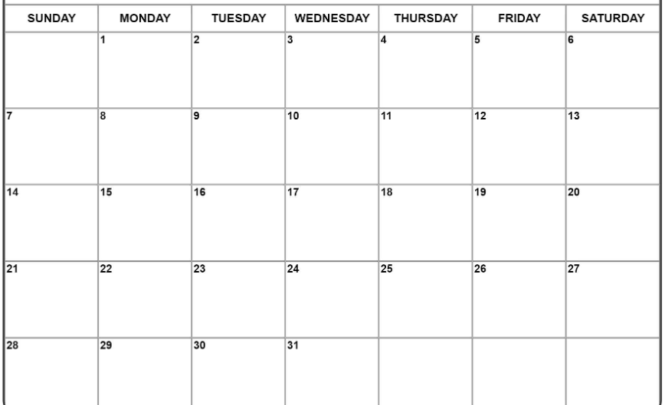
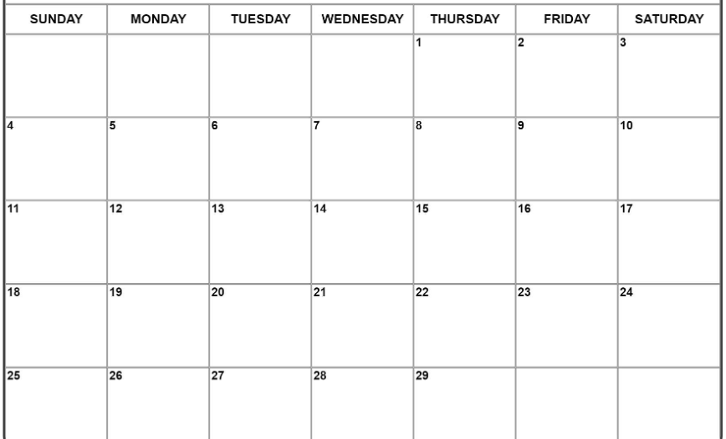
Pack/Troop ### Calendar – Spring Semester, 2024
Dates and plans are accurate as of December 2023. Any unanticipated changes to this calendar will be communicated as soon as they are known.
Note: Webelos II should begin visiting area Troops this month in advance of February 18 cross over; leaders will have lists
Text box
Text box
No school
Text box
Scout Sunday - attend HUMC service, activity after
Cmtee Mtg 6PM, HUMC; discuss Pack(s) future leadership
Text box
No school
Text box
No school
Text box
Pack/Den Meeting
6PM, HUMC

Slide 2
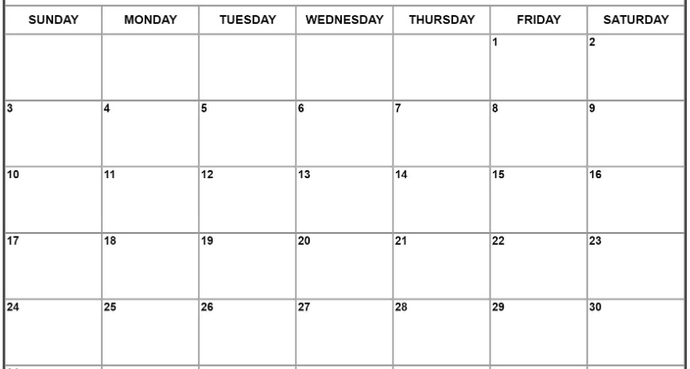
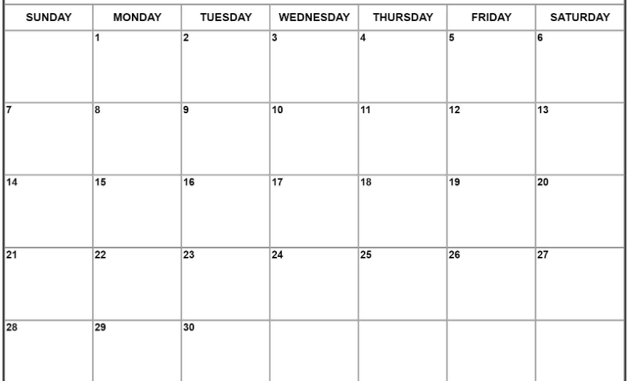
Text box
Text box
Text box
No school – EVSC Spring Break
Easter
No school

Slide 3
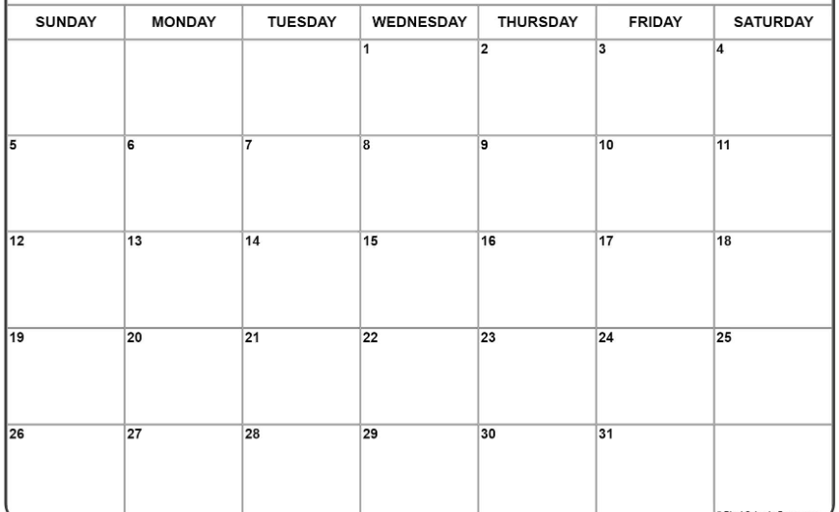
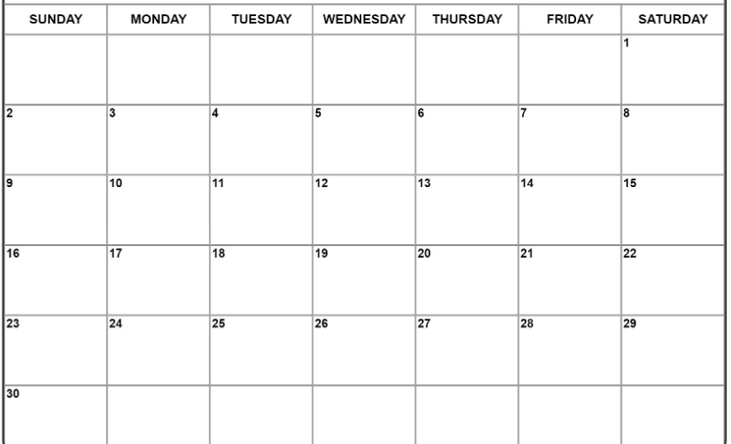
Text box
Text box
Text box
Summer Dates to Note
Date/time/activity
Date/time/activity

