Slide 1
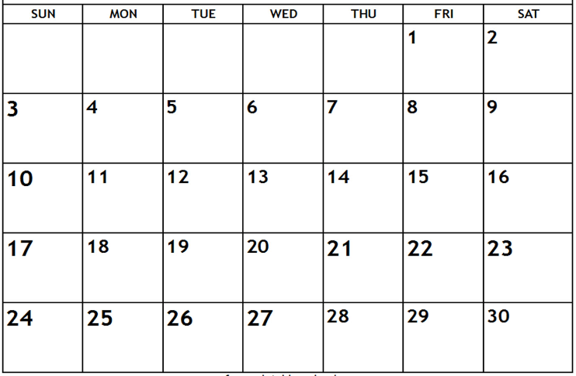
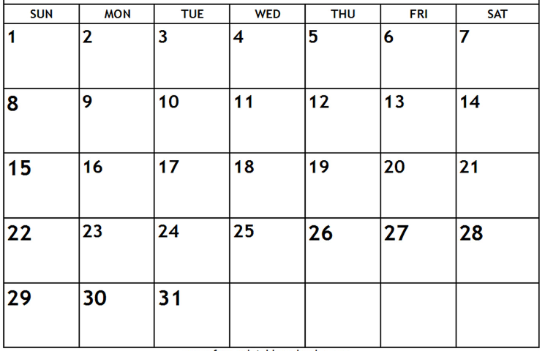
Pack/Troop ### Calendar – Fall Semester, 2023
Day, August __ – first Pack/Den/Troop meeting, time, location
Day, August __ – event, time location
Text box
Text box
text box
text box
Popcorn Blitz Weekend
There will popcorn storefront sales opportunities during the weeks of sales season—usually 2 hour shifts on weekends.
Text box
Text box
******* EVSC Fall Break – No School **********
text box
(popcorn orders due)

Slide 2
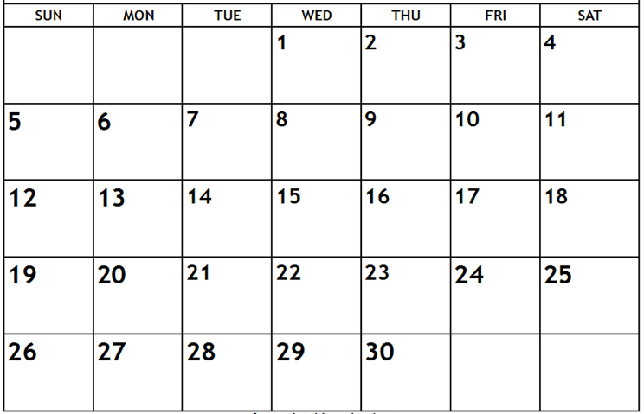
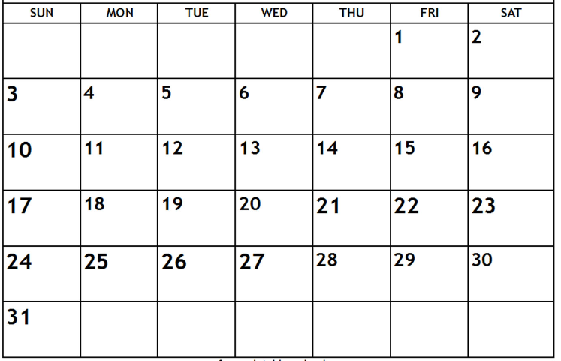
Text box
Text box
text box
No school – Happy Thanksgiving
Text box
Text box
text box
No school– December 18 – January 3 – Merry Christmas, Happy New Year, enjoy your break!
No school– December 18 – January 3 – Merry Christmas, Happy New Year, enjoy your break!
Jan-May 2024 calendar to come…here are first dates in January
Date/event
Date/event

